Slide 1
Effects of interdiffusion on Cu/Ni semi-coherent interface properties
Alex Selimov¹, Kevin Chu¹, David L. McDowell¹
¹School of Materials Science and Engineering Georgia Institute of Technology
October 11, 2022

Slide 2
Overview
Motivation
Methodology
Results
  Effects of interdiffusion on misfit dislocation structures
  Solute cluster and solute segregation
  Effects of solute concentration on interface shear strength
  Microrotation vector analysis of interface deformation
  Qualitative comparison of energy barriers for interface sliding
Conclusions

Slide 3
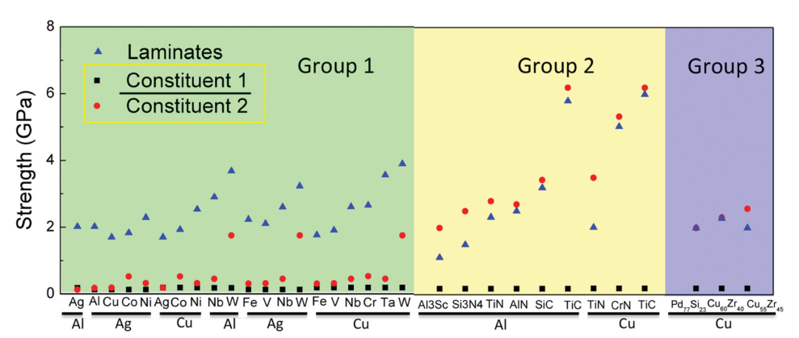
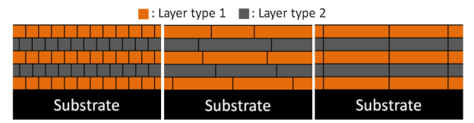
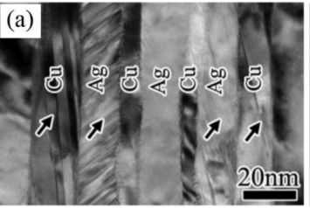
Nanolaminates offer improved properties relative to bulk constituents
Wang, J., Zhou, Q., Shao, S., & Misra, A. (2017). Materials Research Letters, 5(1), 1-19.
Nasim, M., Li, Y., Wen, M., & Wen, C. (2020). Journal of Materials Science & Technology, 50, 215-244.

Slide 4
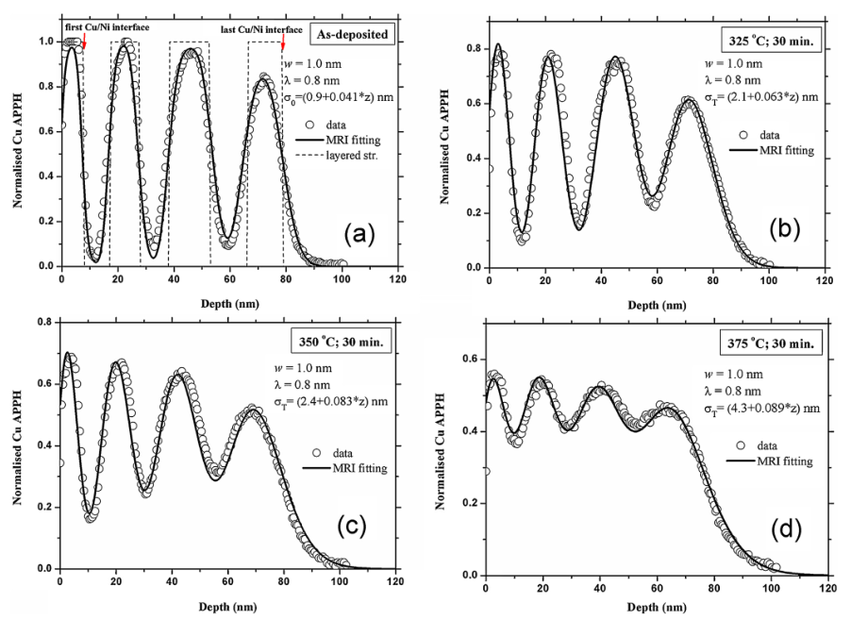
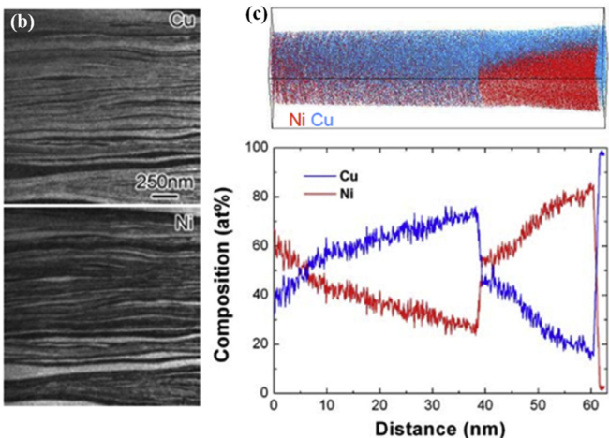
When constituents are miscible, interfaces are diffuse due to interdiffusion of chemical species
Layer composition can be controlled through annealing¹
Accumulative roll bonded multilayer shows alloyed layers²
¹Yan, X. L., Liu, Y., Swart, H. C., Wang, J. Y., & Terblans, J. J. (2016). Applied Surface Science, 364, 567-572.
²Sun, Y., Chen, Y., Tsuji, N., & Guan, S. (2020) Journal of Alloys and Compounds, 819, 152956.

Slide 5
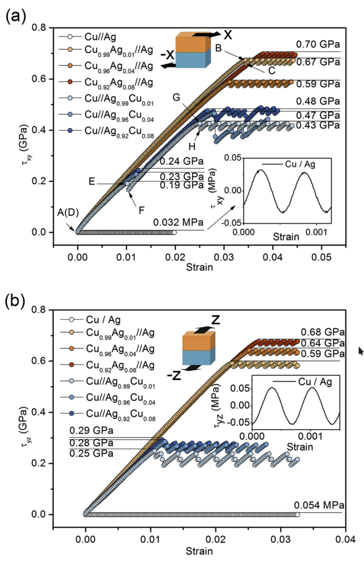
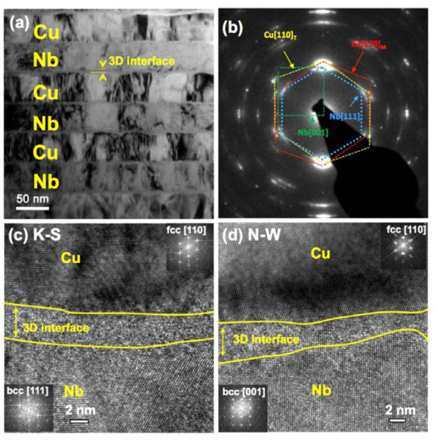
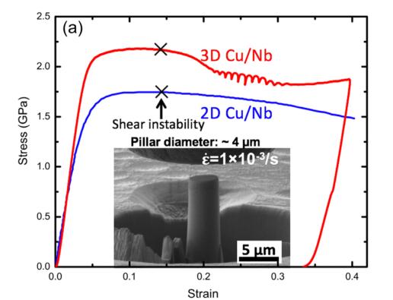
Diffuse interface structures can lead to improved mechanical properties
Chen, Y., Li, N., Hoagland, R. G., Liu, X. Y., Baldwin, J. K., Beyerlein, I. J., ... & Mara, N. A. (2020).. Acta Materialia, 199, 593-601.
Wang, C. J., Yao, B. N., Liu, Z. R., Kong, X. F., Legut, D., Zhang, R. F., & Deng, Y. (2020). International Journal of Plasticity, 131, 102725.

Slide 6
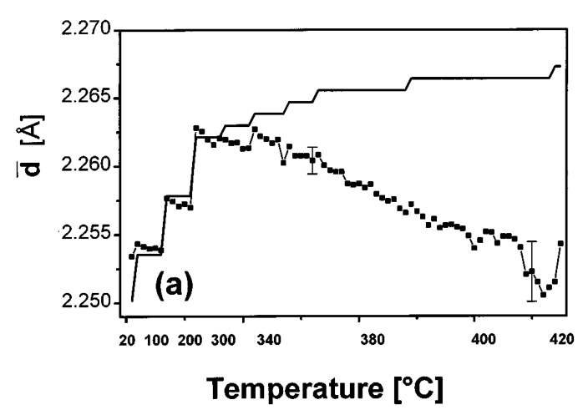
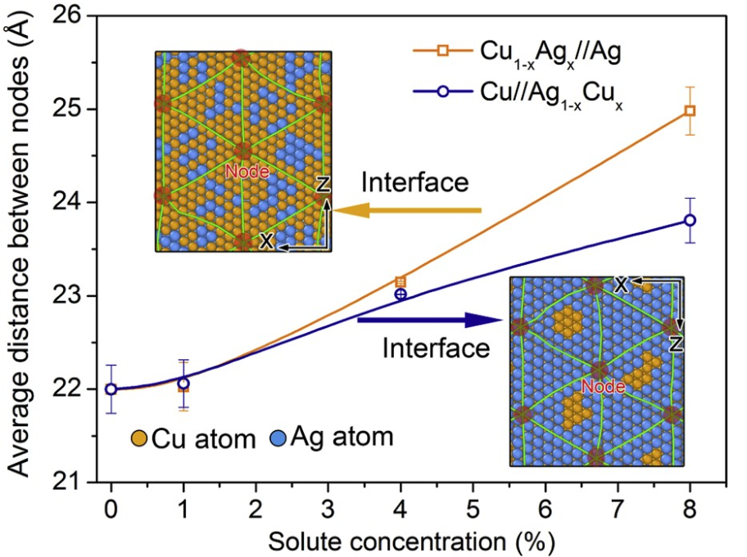
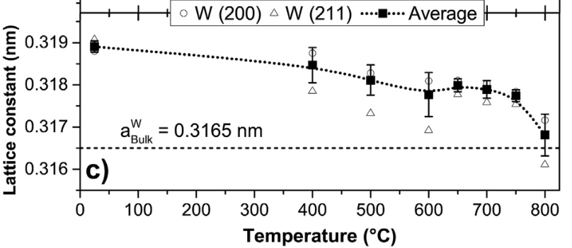
Explicit consideration of misfit dislocation density changes is required.
Chladek, M., Dorner, C., Buchal, A., Valvoda, V., & Hoffmann, H. (1996). Journal of applied physics, 80(3), 1437-1445.
Wang, C. J., Yao, B. N., Liu, Z. R., Kong, X. F., Legut, D., Zhang, R. F., & Deng, Y. (2020). International Journal of Plasticity, 131, 102725.
Small change in lattice parameters should lead to significant changes in interface misfit structure
Moszner, F., Cancellieri, C., Chiodi, M., Yoon, S., Ariosa, D., Janczak-Rusch, J., & Jeurgens, L. P. H. (2016). Acta Materialia, 107, 345-353.

Slide 7
Overview
Motivation
Methodology
Results
  Effects of interdiffusion on misfit dislocation structures
  Solute cluster and solute segregation
  Effects of solute concentration on interface shear strength
  Microrotation vector analysis of interface deformation
  Qualitative comparison of energy barriers for interface sliding
Conclusions

Slide 8
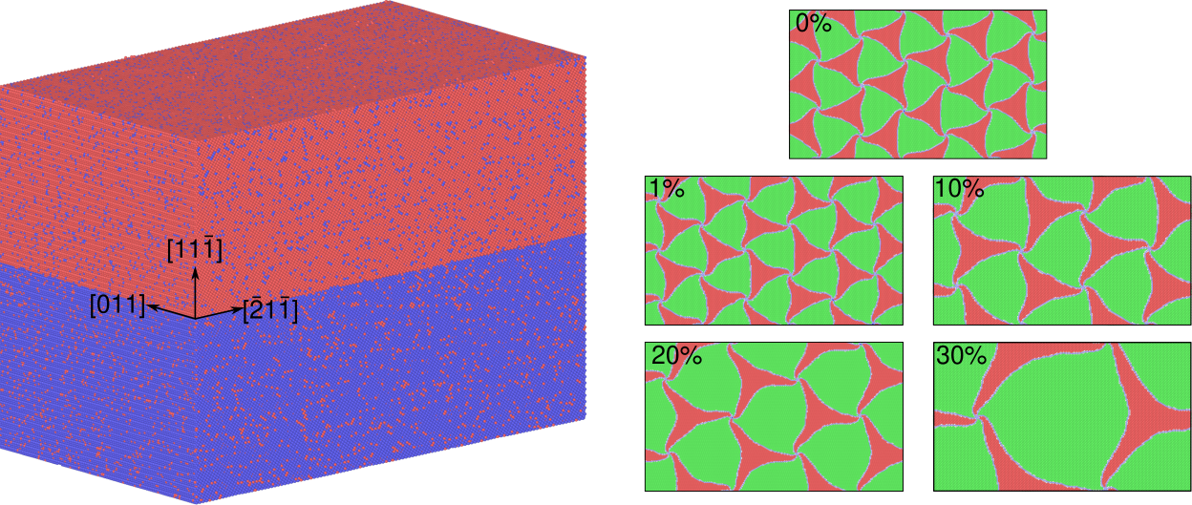
Cu/Ni bicrystals are created with both lower misfit density and presence of solutes
Selimov, A., Chu, K., & McDowell, D. L. (2022). International Journal of Plasticity, 157, 103393.

Slide 9
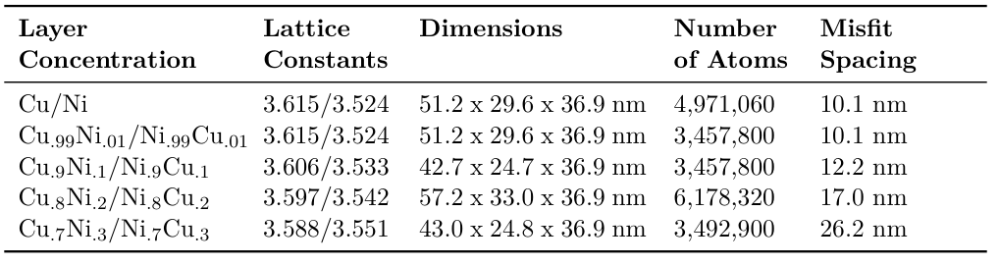
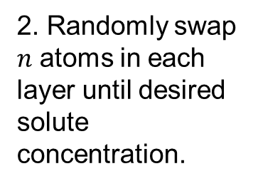

Methodology for developing model geometries
1. Generate individual Cu/Ni layers with concentration dependent lattice constant.
2. Randomly swap $n$ atoms in each layer until desired solute concentration.
3. Stack each layer.
4. Run hybrid MC/MD at 700 K until reasonable convergence.
$$a_{avg}=a_{Cu}⋅X_{Cu}+a_{Ni}⋅X_{Ni}$$

Slide 10
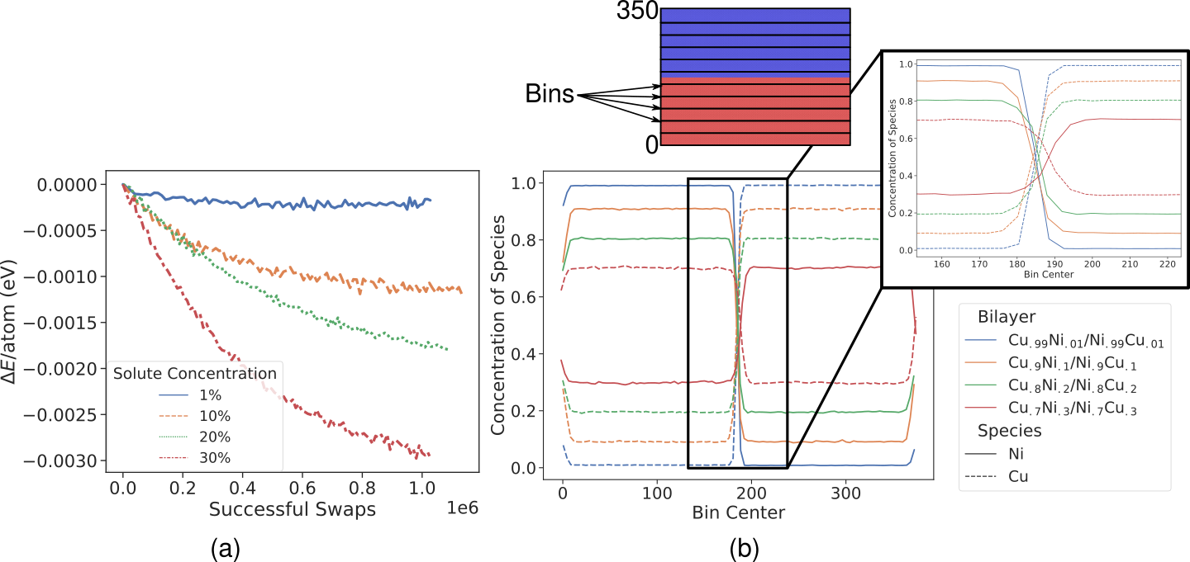
Hybrid Monte-Carlo/Molecular Dynamics used to generate diffuse interface structures
Selimov, A., Chu, K., & McDowell, D. L. (2022). International Journal of Plasticity, 157, 103393.

Slide 11

Microrotation vector is defined from the atomic deformation gradient
Microrotation defined by¹:
$$φ_{k}=−\frac{1}{2}ε_{ijk}{\left(R_{skew}\right)}_{ij}$$
where
$$R_{skew}=\frac{1}{2}(R−R^{T})$$
from
$$F=RU$$
¹Tucker, G. J., Zimmerman, J. A., & McDowell, D. L. (2011). International journal of engineering science, 49(12), 1424-1434.

Slide 12
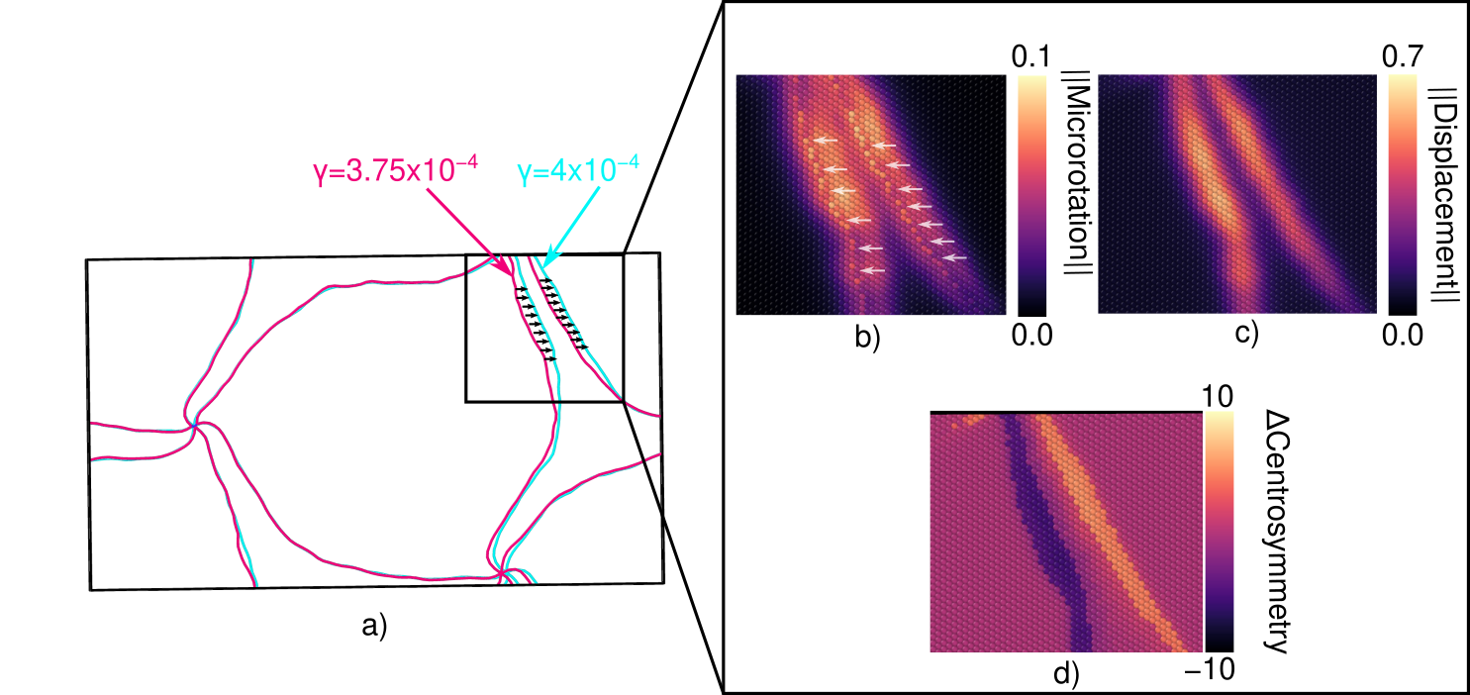
Microrotation analysis used to analyze interface deformation
Selimov, A., Chu, K., & McDowell, D. L. (2022). International Journal of Plasticity, 157, 103393.
Magnitude of vector relates to deformation:
0.07 – Dislocation Glide
0.18 – Grain Boundary Migration

Slide 13
Overview
Motivation
Methodology
Results
  Effects of interdiffusion on misfit dislocation structures
  Solute cluster and solute segregation
  Effects of solute concentration on interface shear strength
  Microrotation vector analysis of interface deformation
  Qualitative comparison of energy barriers for interface sliding
Conclusions

Slide 14
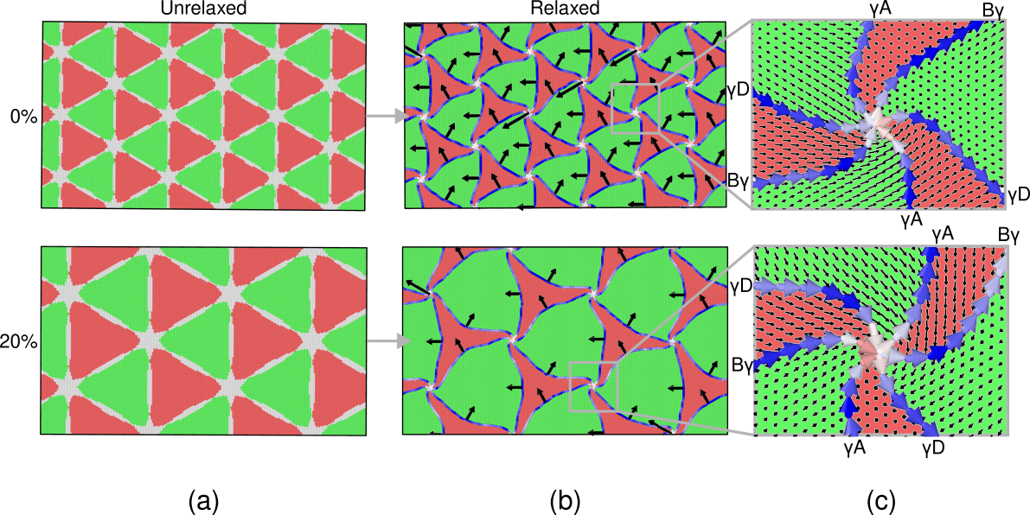
Primary difference in interface structure is the misfit dislocation density
Selimov, A., Chu, K., & McDowell, D. L. (2022). International Journal of Plasticity, 157, 103393.

Slide 15
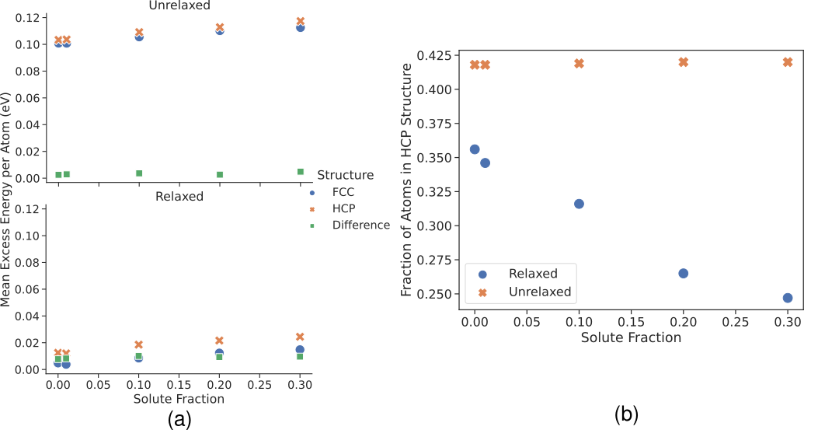
Stacking fault energy of the interface may not significantly change for diffuse interfaces
Decrease may result from dislocation curvature
No clear trend in energy
Selimov, A., Chu, K., & McDowell, D. L. (2022). International Journal of Plasticity, 157, 103393.

Slide 16
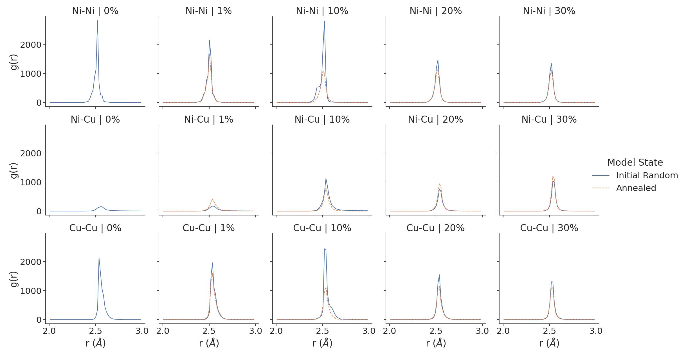
Solutes are not observed to form clusters at the interface
*Calculated using Ovito¹
Decrease
Increase
Decrease
Selimov, A., Chu, K., & McDowell, D. L. (2022). International Journal of Plasticity, 157, 103393.
¹Stukowski, A. (2009). Modelling and simulation in materials science and engineering, 18(1), 015012.

Slide 17
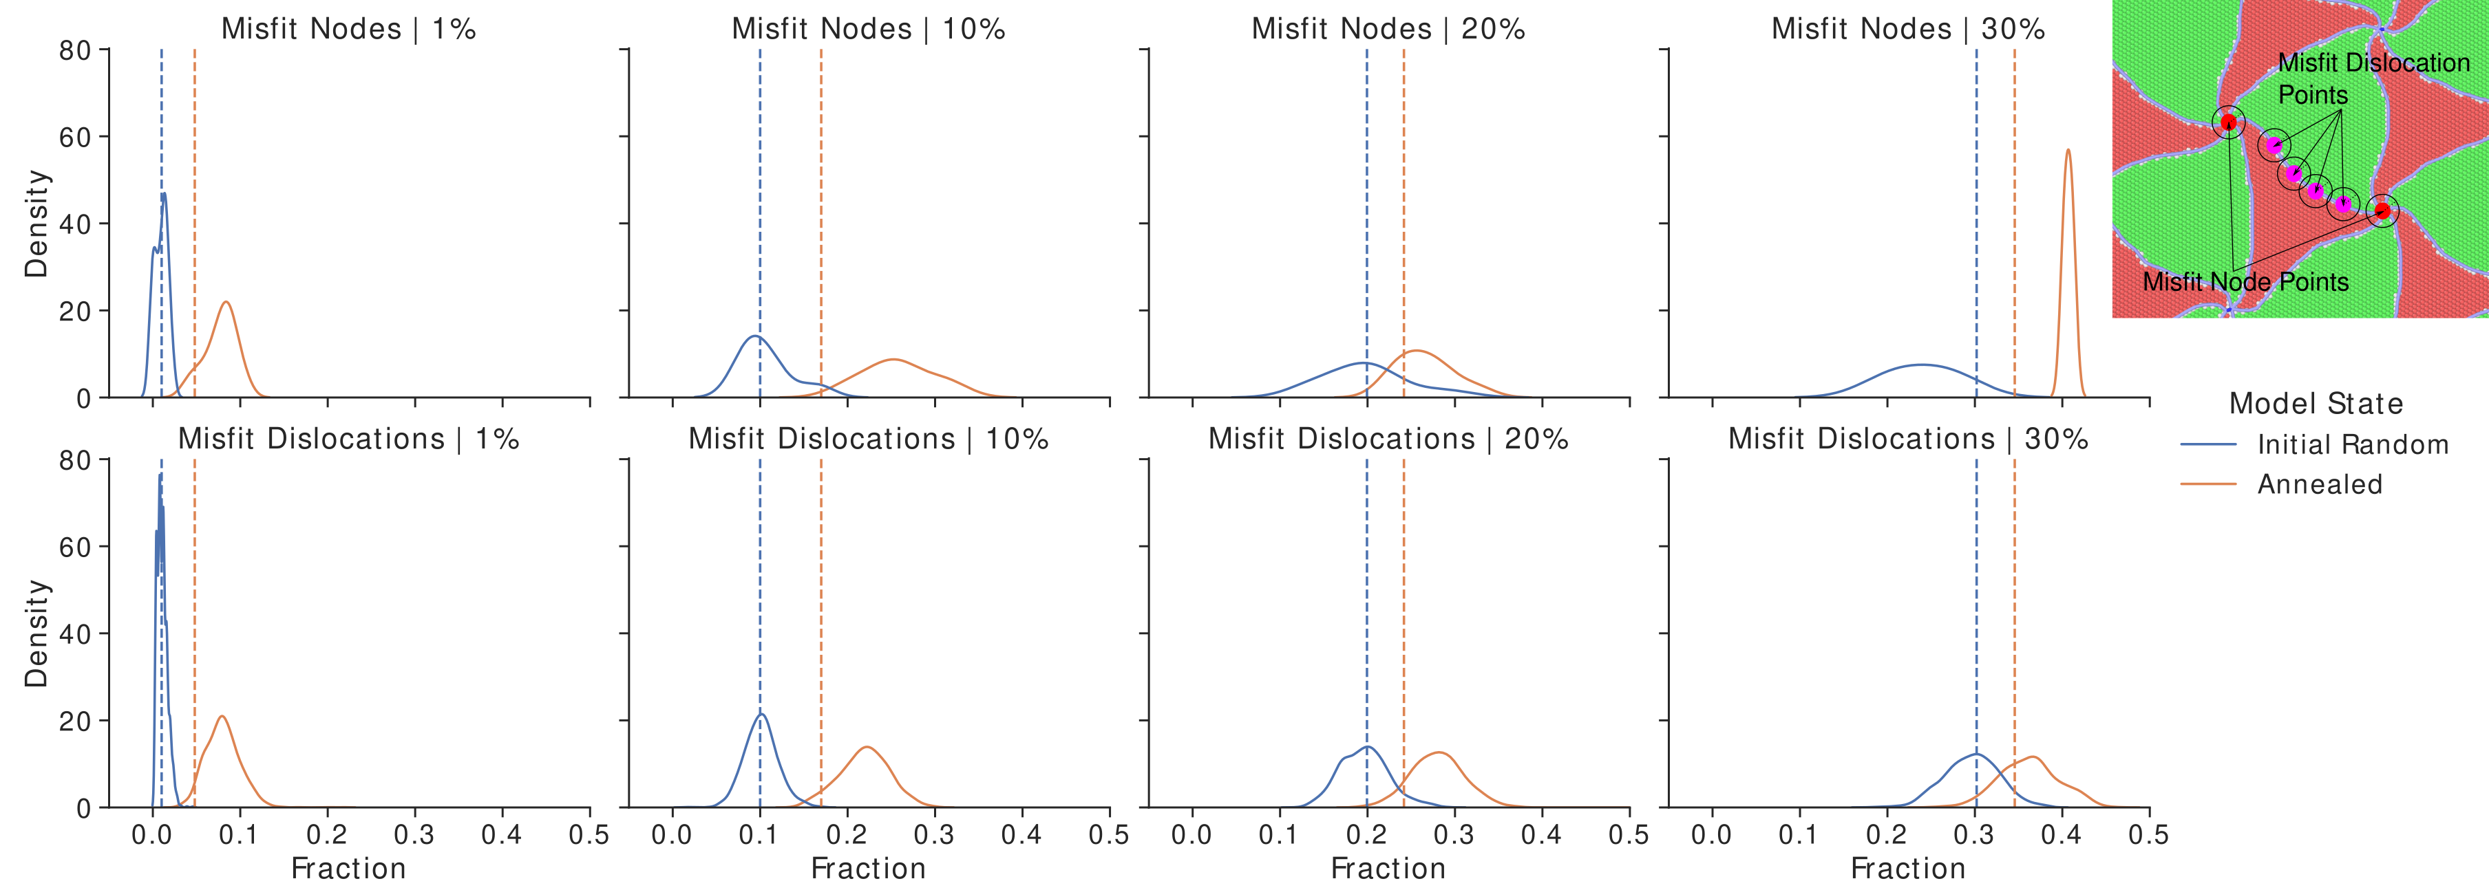
Solutes preferably segregate to misfit nodes and to misfit dislocations
Selimov, A., Chu, K., & McDowell, D. L. (2022). International Journal of Plasticity, 157, 103393.

Slide 18
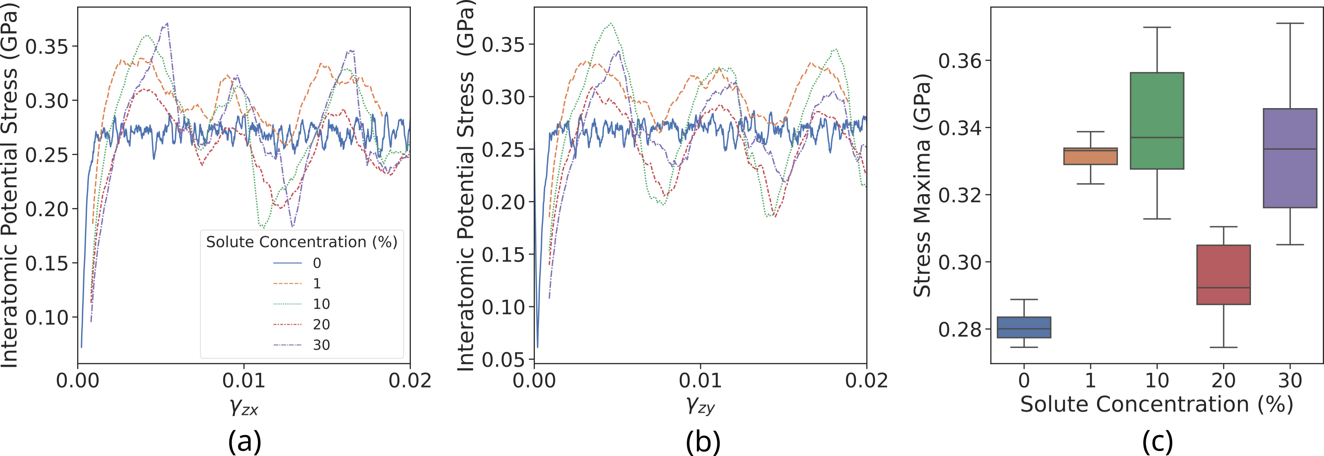
Stress-strain response exhibits improved shear strength with interdiffusion
Median values are similar
Distributed maximum shear stresses
20% is outlier
Selimov, A., Chu, K., & McDowell, D. L. (2022). International Journal of Plasticity, 157, 103393.

Slide 19
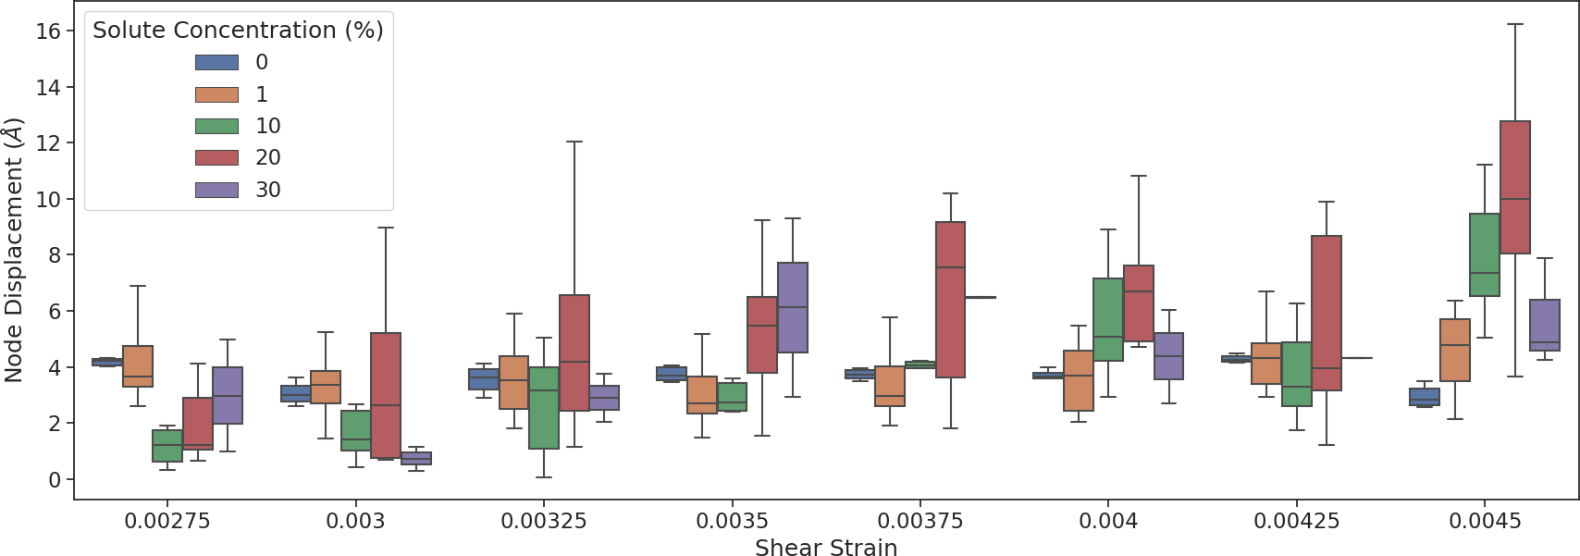
Larger maximum node displacements are observed with interdiffusion. Larger spread in values implies distributed energy barriers.
Selimov, A., Chu, K., & McDowell, D. L. (2022). International Journal of Plasticity, 157, 103393.

Slide 20
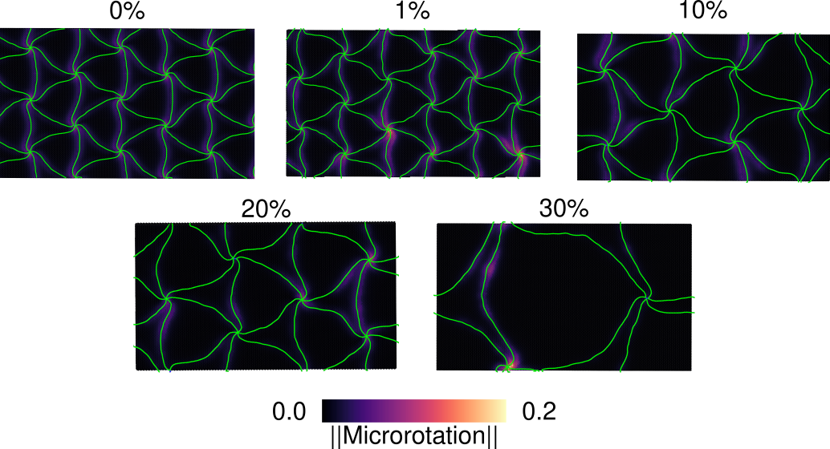
Microrotation maps reveal non-uniform interface deformation
Higher local deformation
Selimov, A., Chu, K., & McDowell, D. L. (2022). International Journal of Plasticity, 157, 103393.

Slide 21
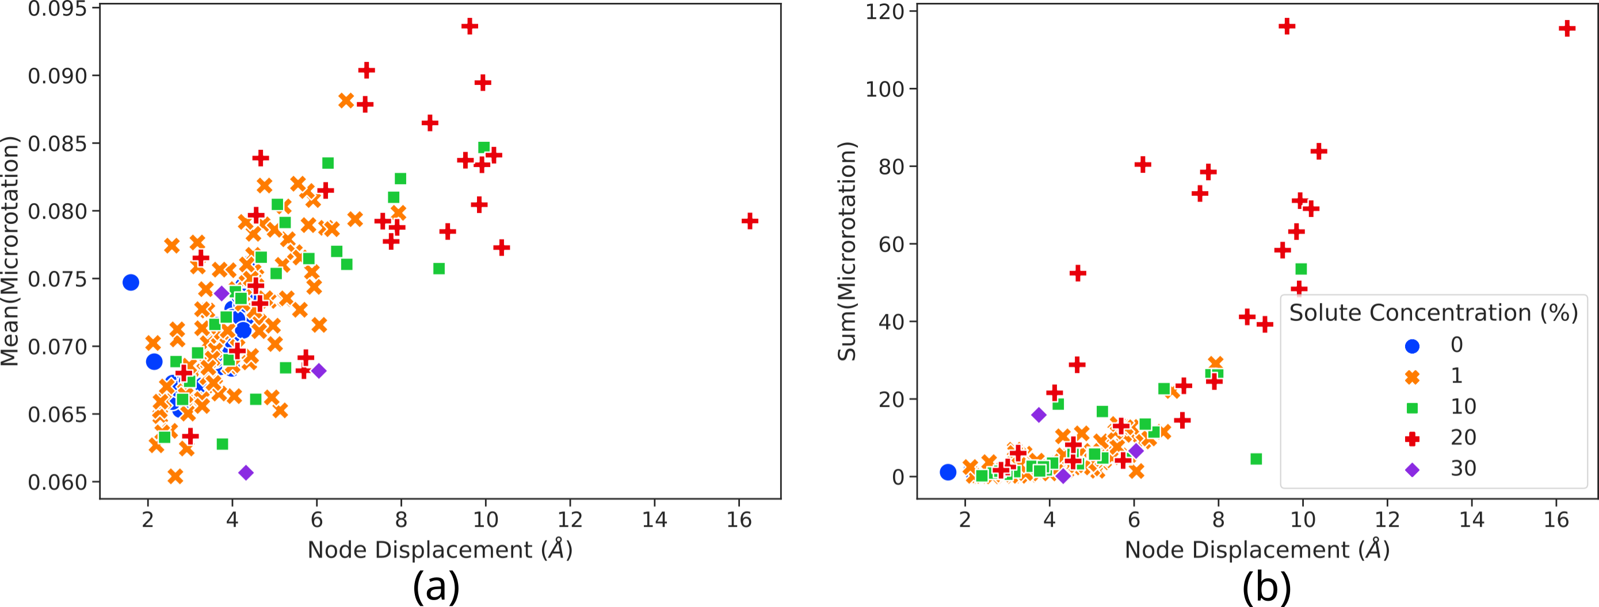
Microrotation magnitudes correspond to node displacements
20% exhibits larger microrotation sum for node displacement
Linear trend between node displacement and average microrotation
Selimov, A., Chu, K., & McDowell, D. L. (2022). International Journal of Plasticity, 157, 103393.

Slide 22
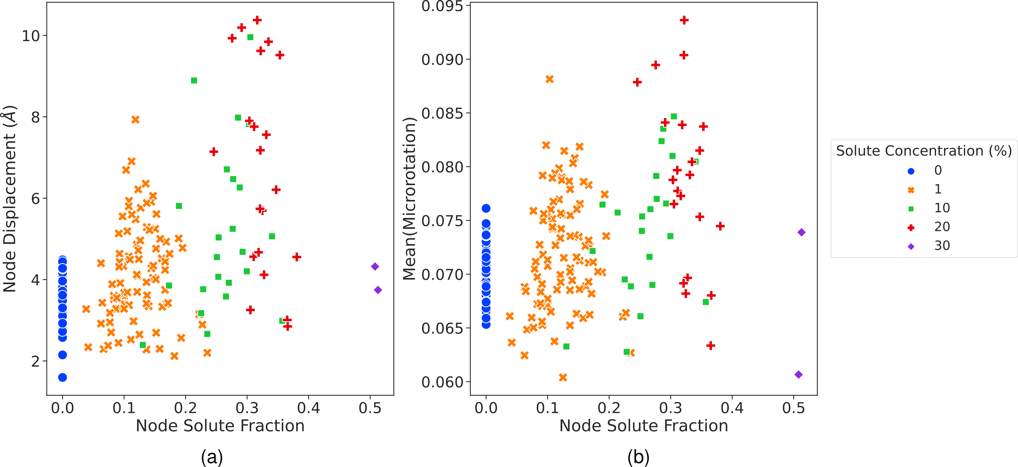
Node displacement and node microrotation does not depend on the local solute fraction
Selimov, A., Chu, K., & McDowell, D. L. (2022). International Journal of Plasticity, 157, 103393.
Longer range configuration between interface solutes and interface misfits may be more important

Slide 23
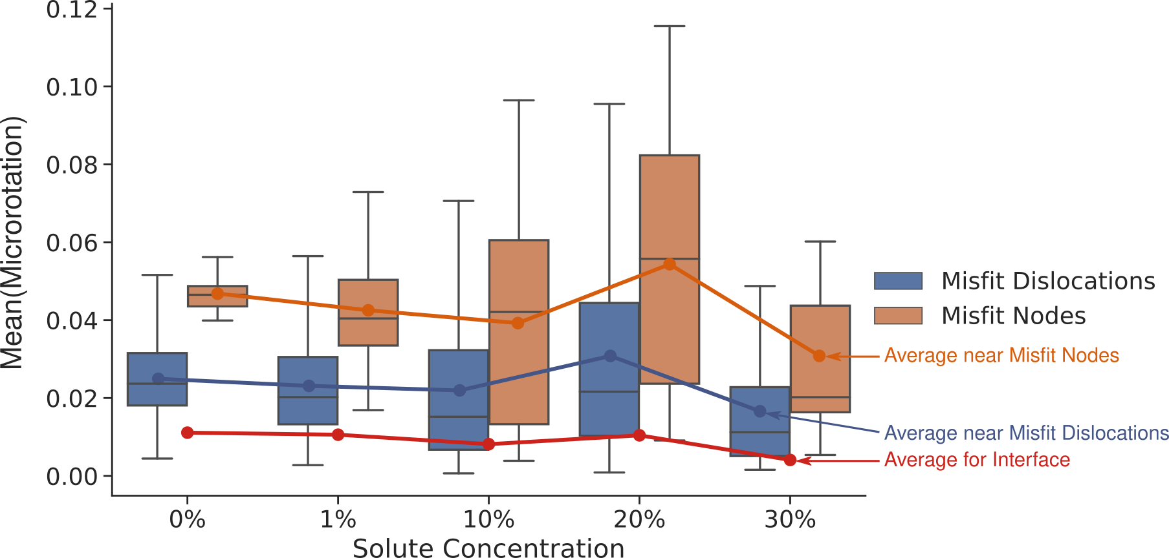
Interface deformation is primarily constrained to misfit nodes. Increase in range may be due to distributed resistance
20% exhibits highest median misfit dislocation and misfit node deformation
Maximum microrotations go up
Selimov, A., Chu, K., & McDowell, D. L. (2022). International Journal of Plasticity, 157, 103393.

Slide 24
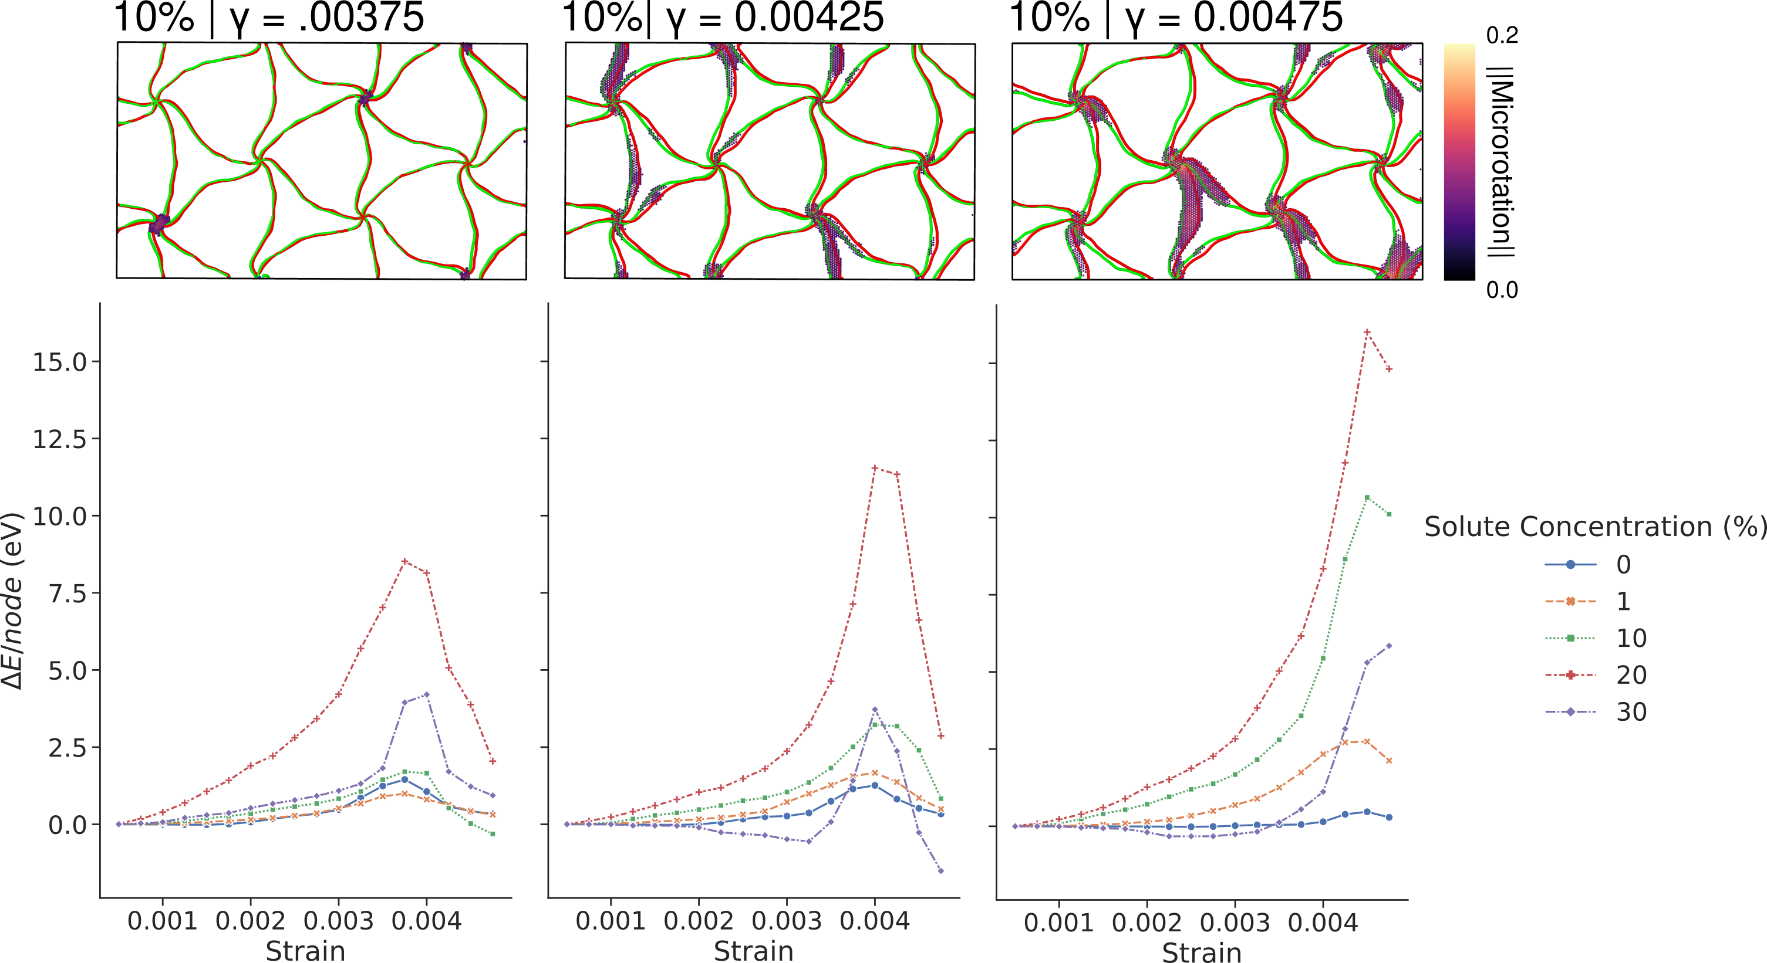
Energy change per node supports distributed energy barriers for diffuse interfaces
aaa
20% remains outlier
Selimov, A., Chu, K., & McDowell, D. L. (2022). International Journal of Plasticity, 157, 103393.

Slide 25
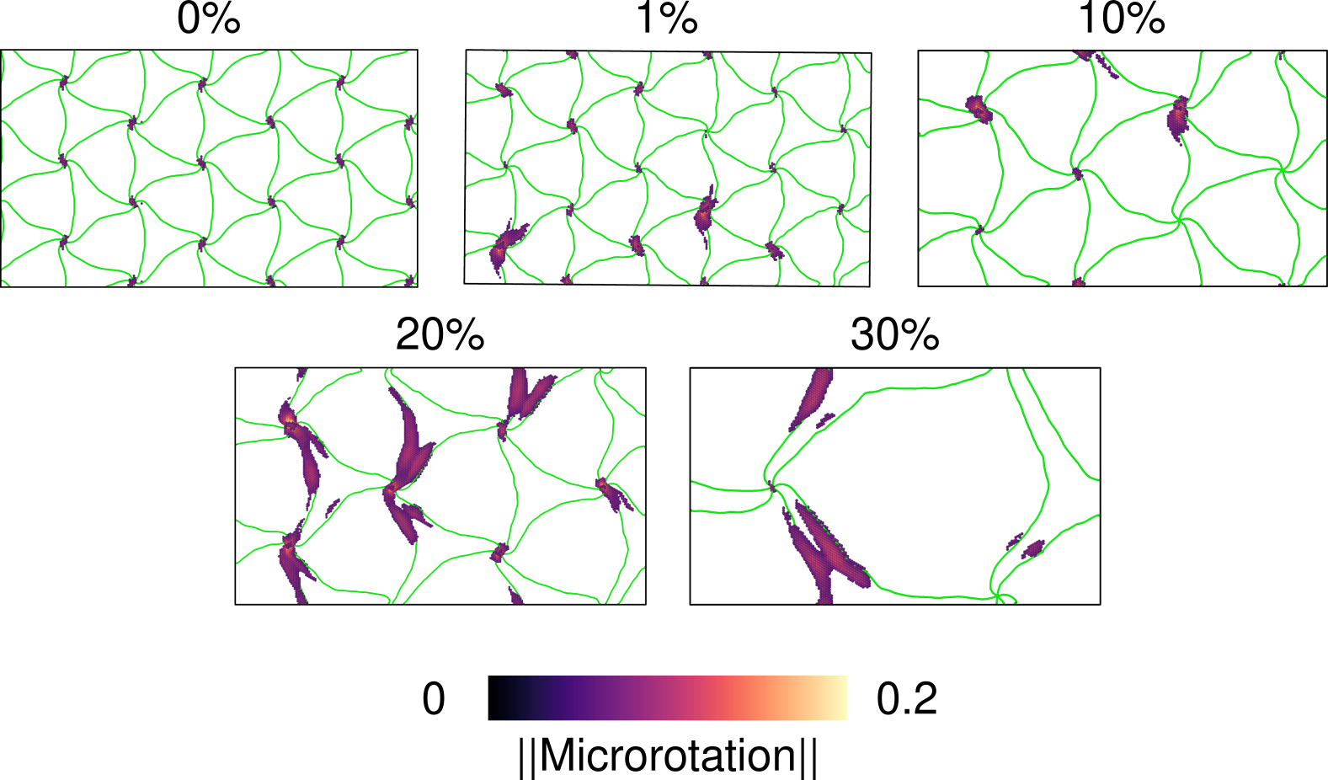
Difference in energy may be due to the activation of misfit dislocation glide
Selimov, A., Chu, K., & McDowell, D. L. (2022). International Journal of Plasticity, 157, 103393.

Slide 26
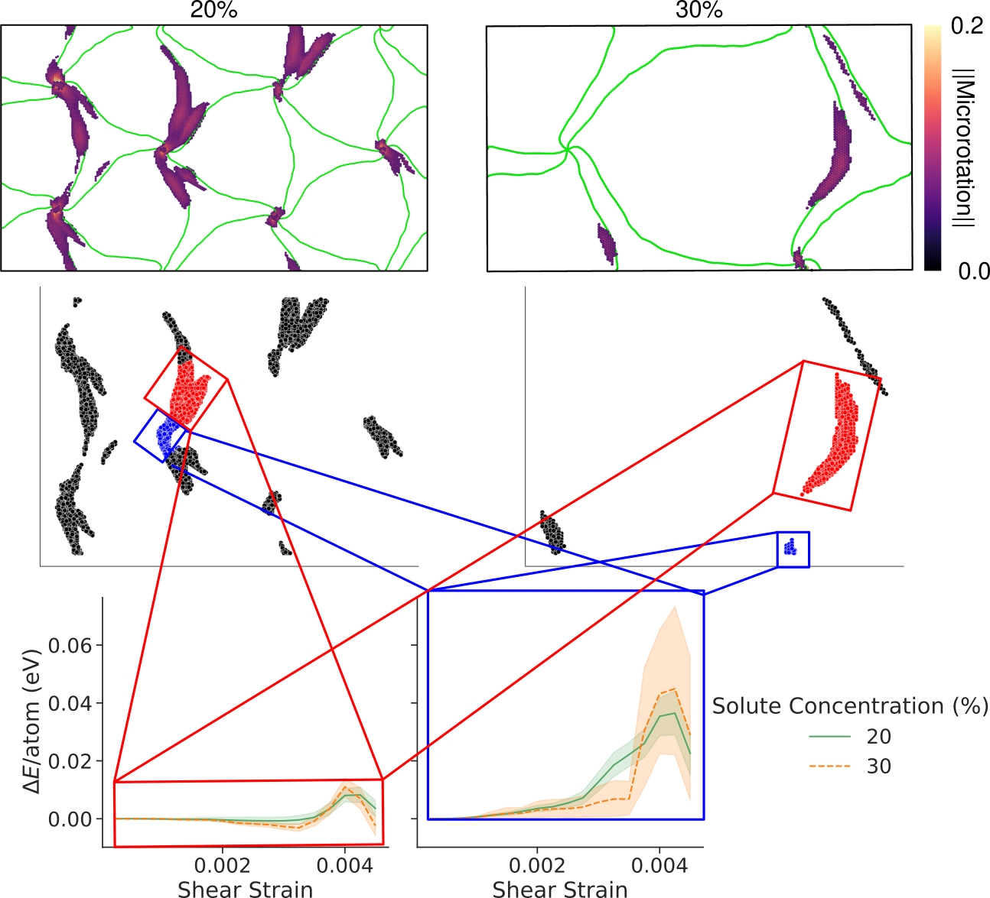
Comparison of energy changes for only misfit node glide leads to expected trend.
Higher barrier indicates misfit node glide is the rate-limiting process in interface sliding
Selimov, A., Chu, K., & McDowell, D. L. (2022). International Journal of Plasticity, 157, 103393.

Slide 27
Conclusions
Interdiffusion leads to slight increases in shear strength of Cu/Ni nanolaminates.
Local solute concentration does not correlate with localized interface deformation indicating the importance of longer-range structure. Need description of longer-range structure.
A switch from uniform interface sliding to localized interface sliding is observed based on distributed energy barriers.
Misfit node glide facilitates misfit dislocation glide and is the rate-limiting step in the process.

Slide 28


Acknowledgements
This work is based on research supported by the National Science Foundation under the Grants CMMI-1761553.
All presented simulations were conducted using XSEDE resources under the allocation TG-MSS150010.

Slide 29
Thank you! Questions?

Slide 30
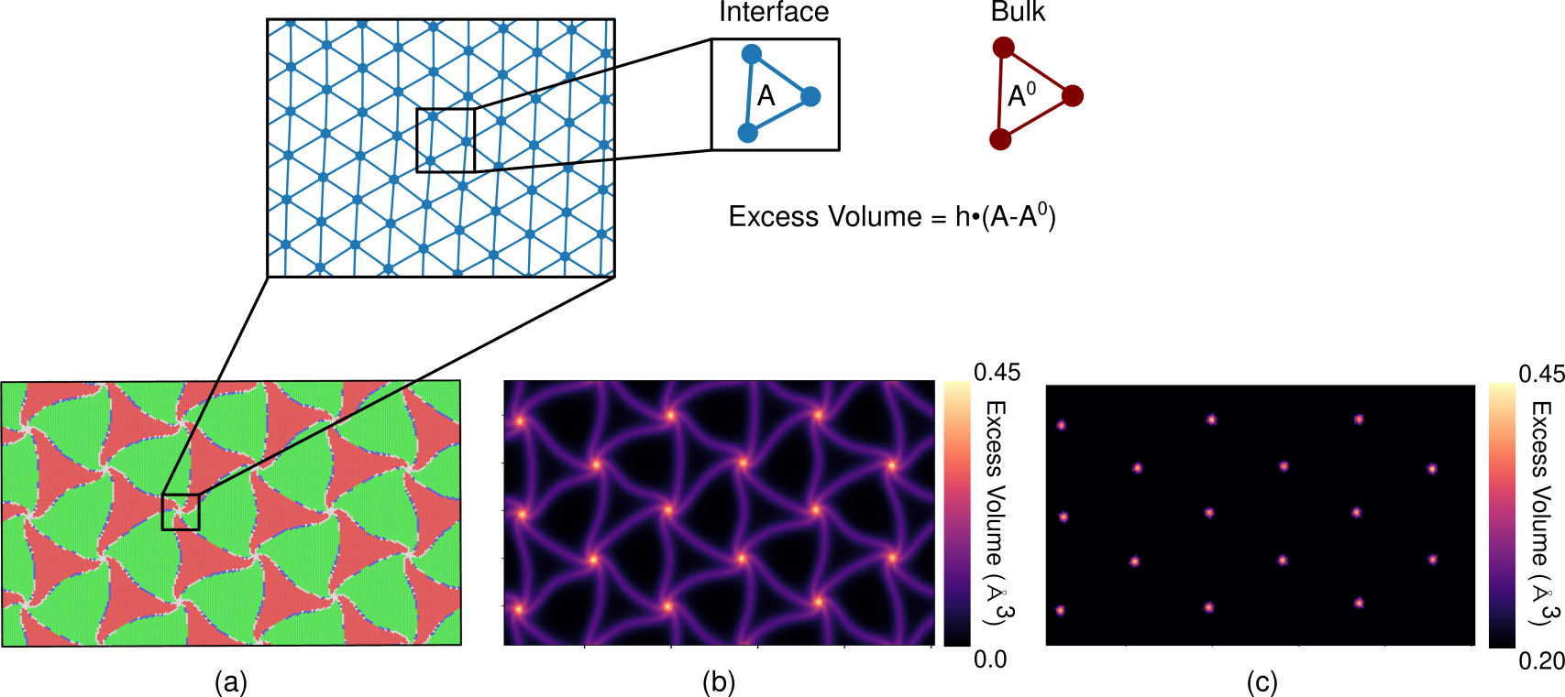
Interface excess volume analysis¹ used to track evolution of misfit dislocation structure
Locally high excess volume attributed to misfit node
Selimov, A., Chu, K., & McDowell, D. L. (2022). International Journal of Plasticity, 157, 103393.
¹Shao, S., Wang, J., & Misra, A. (2014). Journal of Applied Physics, 116(2), 023508.

