Slide 1

Concurrent Atomistic-Continuum studies of confined layer slip in Cu/Ni nanolaminates
Alex Selimov¹, Youping Chen², David L. McDowell¹
¹School of Materials Science and Engineering Georgia Institute of Technology
²Dept. Mechanical and Aerospace Engineering University of Florida
October 6, 2022

Slide 2

Overview
Motivation
Methodology
Results
  Dislocation Generation Mechanisms
  Dislocation/Interface Interactions
  Energetics of Confined Layer Slip
Conclusions

Slide 3
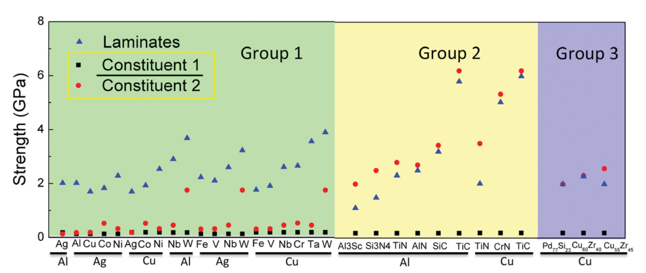
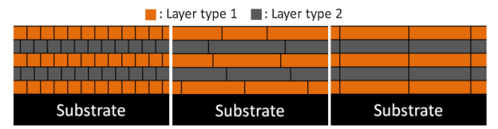
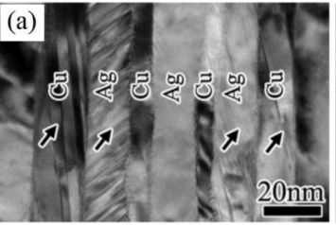
Nanolaminates offer improved properties relative to bulk constituents
Wang, J., Zhou, Q., Shao, S., & Misra, A. (2017). Materials Research Letters, 5(1), 1-19.
Nasim, M., Li, Y., Wen, M., & Wen, C. (2020). Journal of Materials Science & Technology, 50, 215-244.

Slide 4
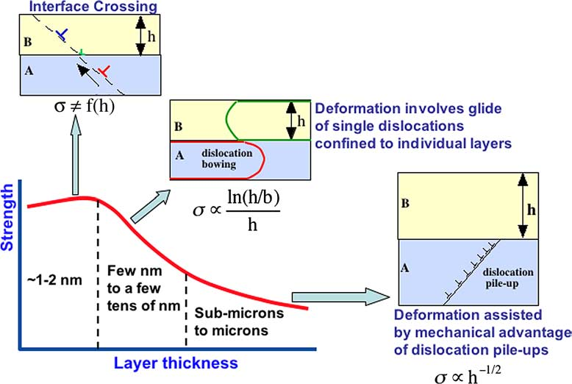
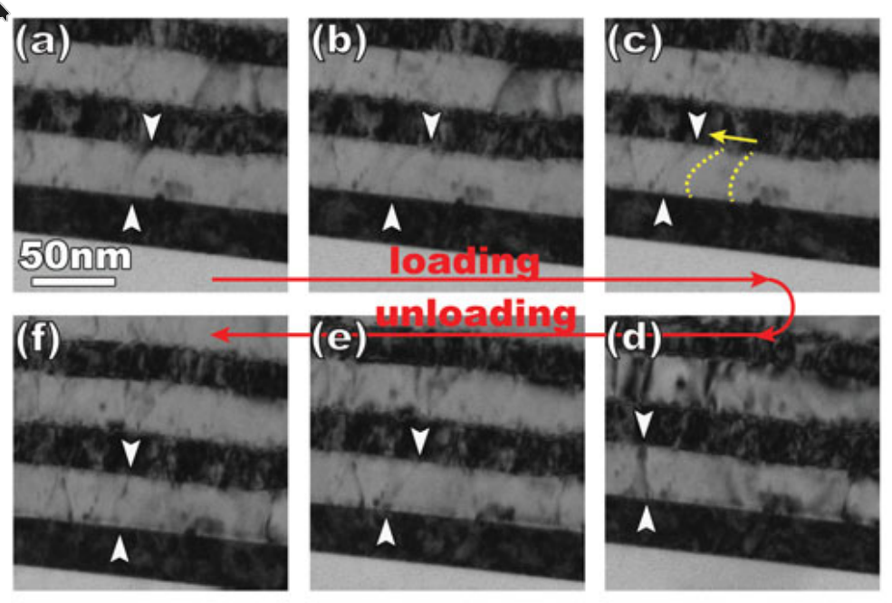
Confined Layer Slip (CLS) is a fundamental deformation mechanism for nanolaminate materials
Has been observed experimentally
Misra, A., Hirth, J. P., & Hoagland, R. G. (2005). Acta materialia, 53(18), 4817-4824.
Li, N., Wang, J., Misra, A., & Huang, J. Y. (2012), 18(5), 1155-1162.

Slide 5
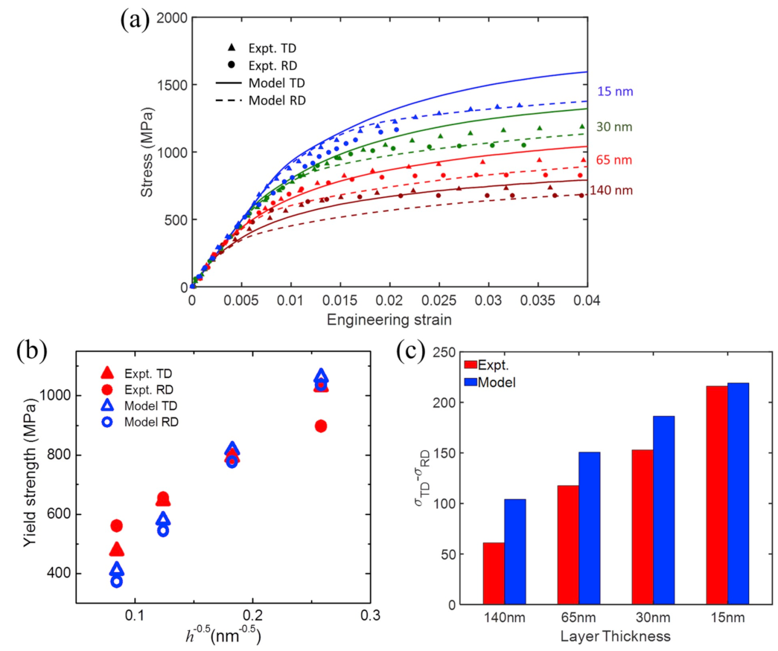
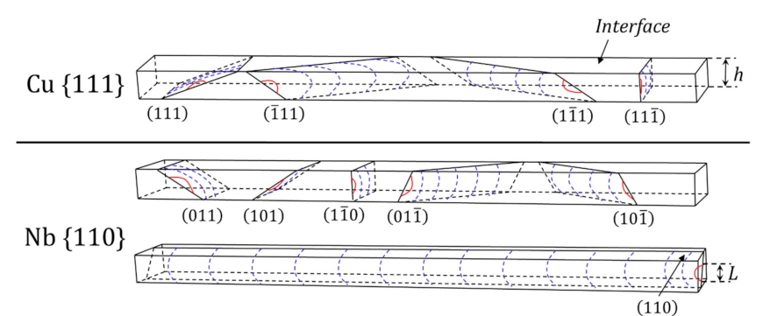
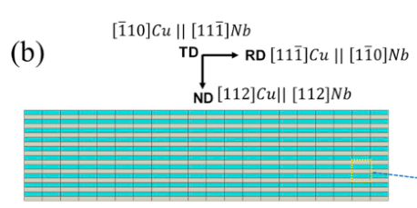
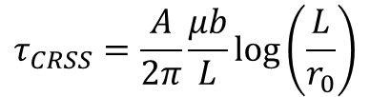
Consideration of interface evolution is important for accurate models of CLS
$$τ_{CRSS}=\frac{A}{2π}\frac{μb}{L}\text{log}\left(\frac{L}{r_{0}}\right)$$
*Treats interfaces as perfect sinks
Chen, T., Yuan, R., Beyerlein, I. J., & Zhou, C., International Journal of Plasticity 124 (2020) 247-260.

Slide 6
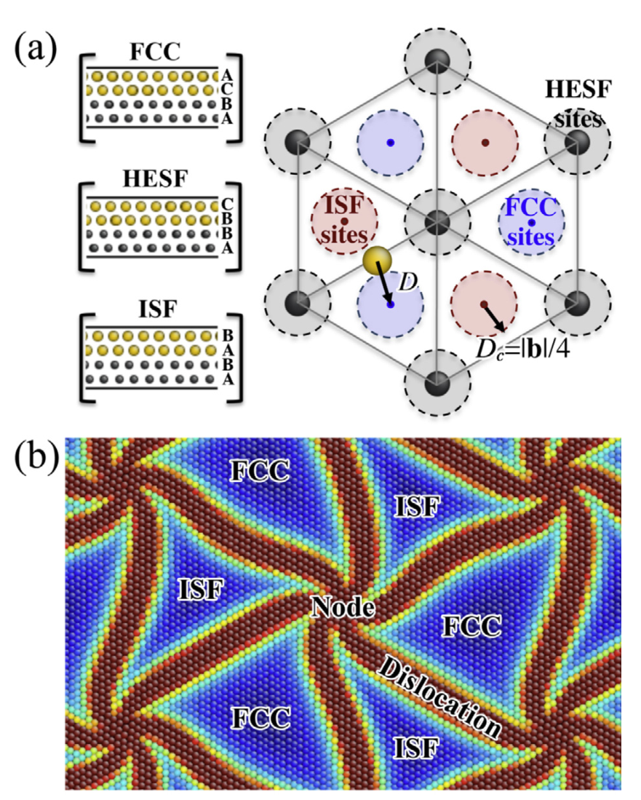
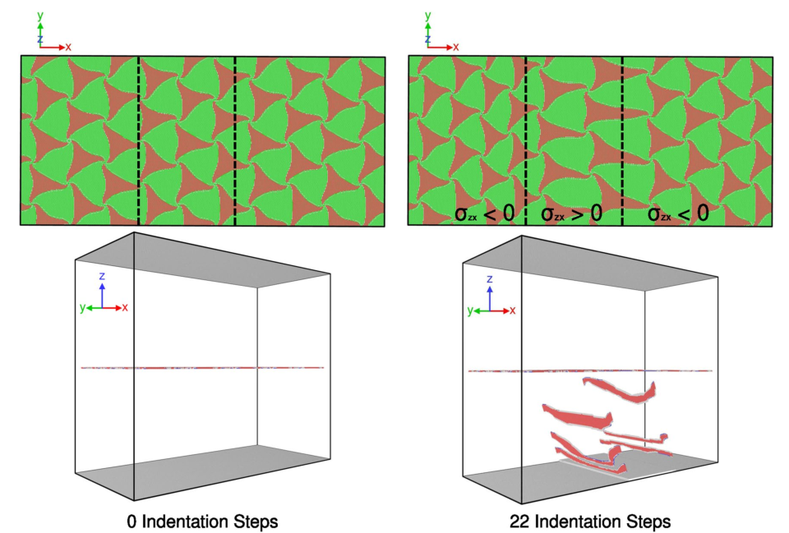
But modeling small interface segments with periodic boundary conditions constrains interface evolution→ multiscale modeling
Shao, S., Wang, J., Beyerlein, I. J., & Misra, A. (2015). Acta Materialia, 98, 206-220.
Selimov, A., Xu, S., Chen, Y., & McDowell, D. (2021). Journal of Materials Research, 36(13), 2763-2778.

Slide 7
Overview
Motivation
Methodology
Results
  Dislocation Generation Mechanisms
  Dislocation/Interface Interactions
  Energetics of Confined Layer Slip
Conclusions

Slide 8
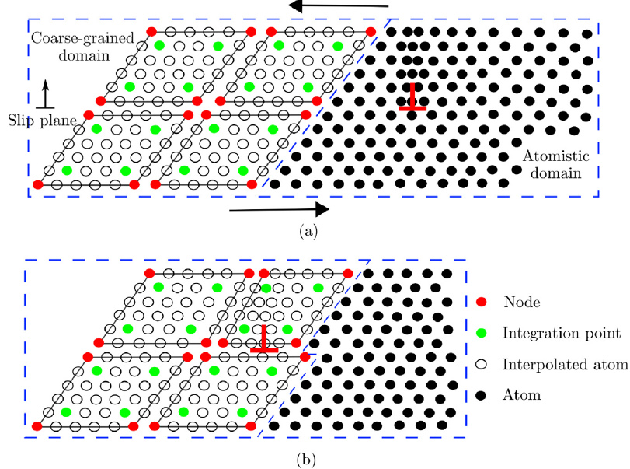
The Concurrent Atomistic-Continuum (CAC) method
Key points:
Coarse-graining reduces degrees of freedom.
Atomistic resolution preserves solution accuracy in certain regions as desired.
Integral form finite element formulation accommodates dislocations in mesh discontinuities.
2NN elements fully capture dislocation stacking faults.
S. Xu et al., International Journal of Plasticity 72 (2015).

Slide 9
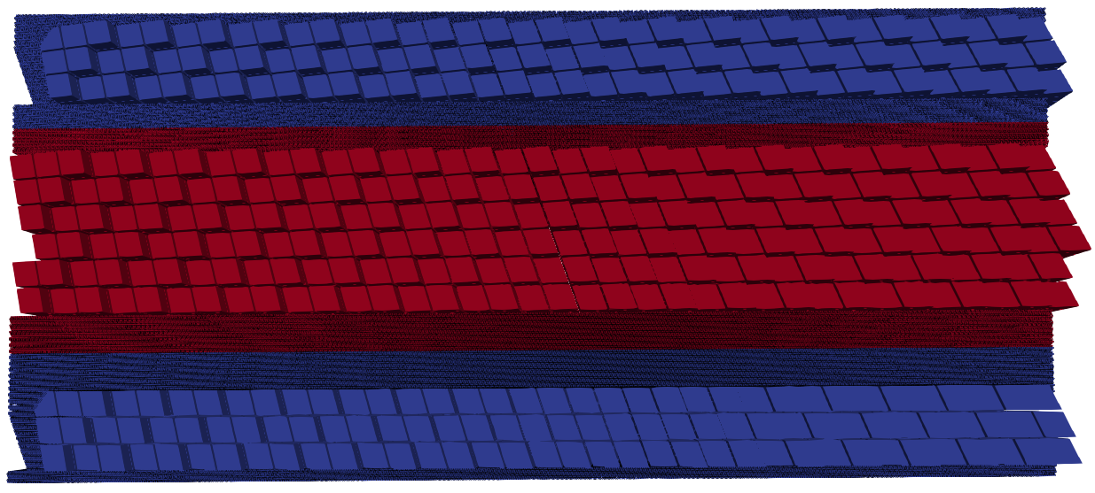
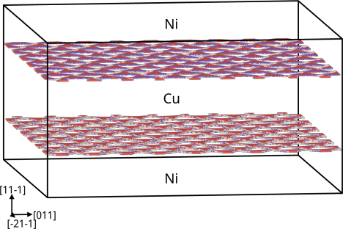
CAC finite element mesh and model geometry
Ni
CG domain
AT domain
Cu
CG domain
AT domain
Ni
CG domain
CAC Mesh
Model Dimensions:104 x 90 x 47 nm
Degrees-of-Freedom: 12,944,073
Atoms in equivalent atomistic model: 38,476,569
Periodic in all dimensions
Onat Cu/Ni Potential¹
¹Onat, B., & Durukanoğlu, S., Journal of Physics: Condensed Matter 26(3) (2013) 035404.

Slide 10
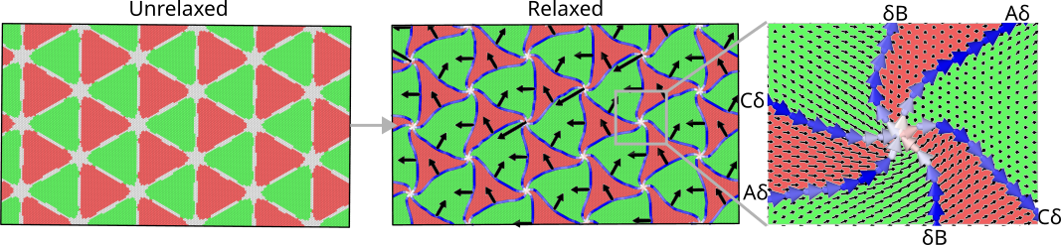
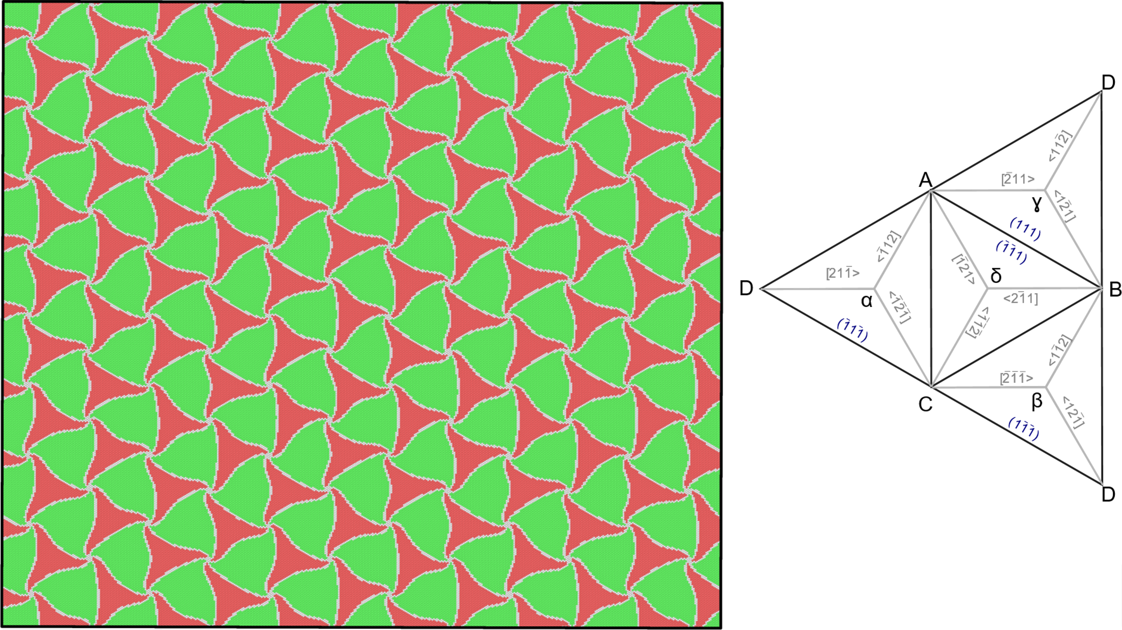
Relaxed semi-coherent interface structure for models under investigation
Selimov, A., Chu, K., & McDowell, D. L. (2022). International Journal of Plasticity, 157, 103393.

Slide 11
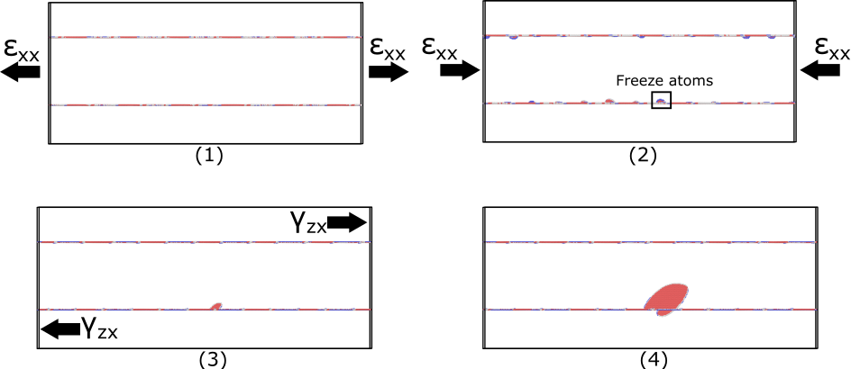
Loading conditions selected to isolate single dislocation loop
*Loading parallel to interface plane
Unload…
Apply Shear …
See also: Zhang, R. F., Wang, J., Beyerlein, I. J., & Germann, T. C., Scripta Materialia 65(11) (2011) 1022-1025.

Slide 12
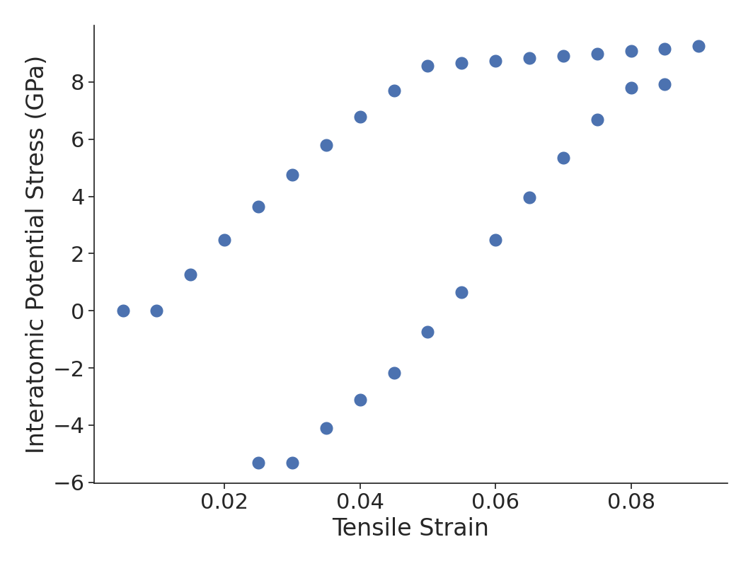
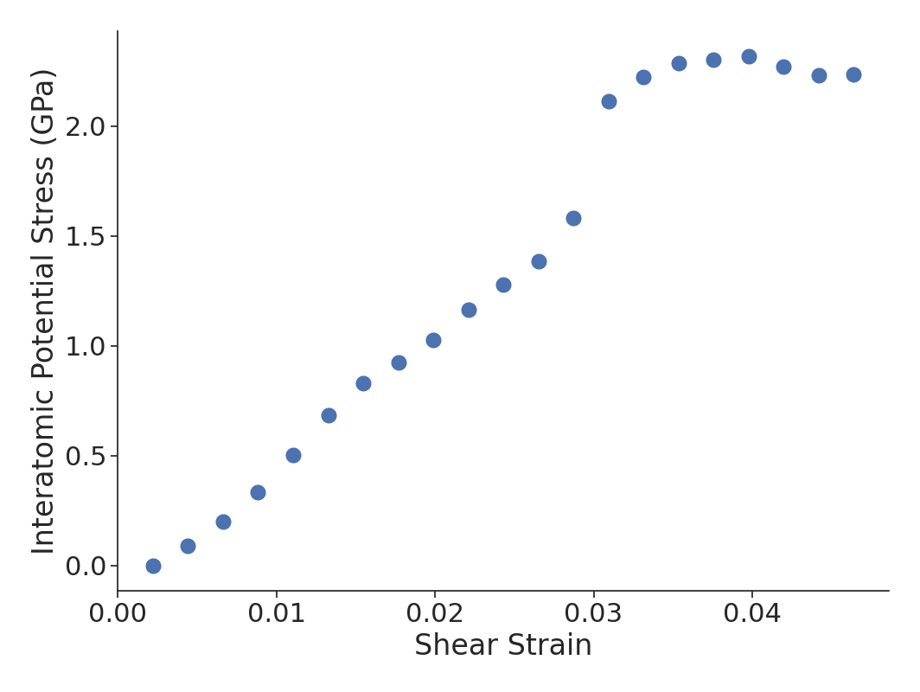
Stress-strain response for geometry
Lattice dislocation impinges on top interface
Hysteresis due to “freezing” interface segment

Slide 13
Overview
Motivation
Methodology
Results
  Dislocation Generation Mechanisms
  Dislocation/Interface Interactions
  Energetics of Confined Layer Slip
Conclusions

Slide 14
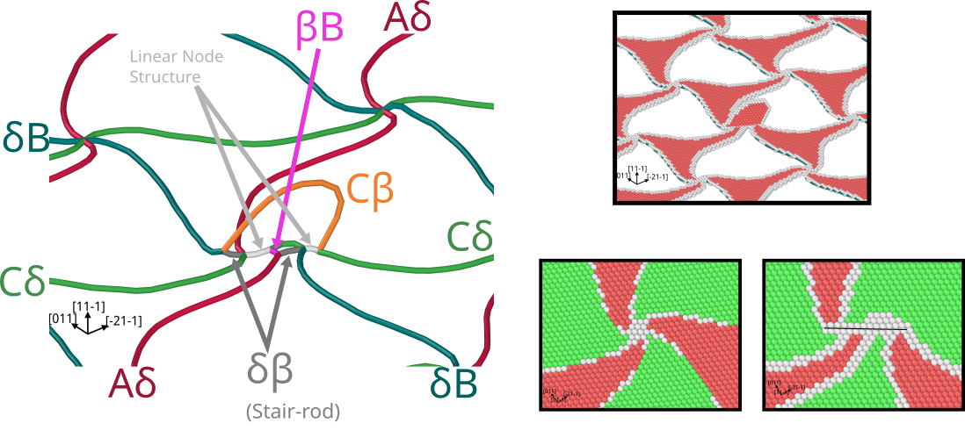

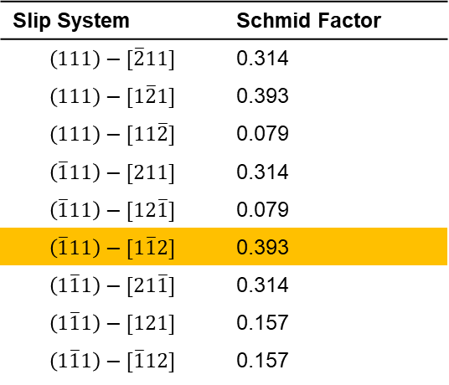
Dislocation generation mechanism exhibits non-Schmid effects
Slip System | Schmid Factor
$$\left(111\right)−[\overline{2}11]$$ | 0.314
$$\left(111\right)−[1\overline{2}1]$$ | 0.393
$$\left(111\right)−[11\overline{2}]$$ | 0.079
$$\left(\overline{1}11\right)−[211]$$ | 0.314
$$\left(\overline{1}11\right)−[12\overline{1}]$$ | 0.079
$$\left(\overline{1}11\right)−[1\overline{1}2]$$ | 0.393
$$\left(1\overline{1}1\right)−[21\overline{1}]$$ | 0.314
$$\left(1\overline{1}1\right)−[121]$$ | 0.157
$$\left(1\overline{1}1\right)−[\overline{1}12]$$ | 0.157
$$δB→Cβ+δβ$$
See also: Chen, X. Y., Kong, X. F., Misra, A., Legut, D., Yao, B. N., Germann, T. C., & Zhang, R. F., Acta Materialia, 143 (2018) 107-120.

Slide 15
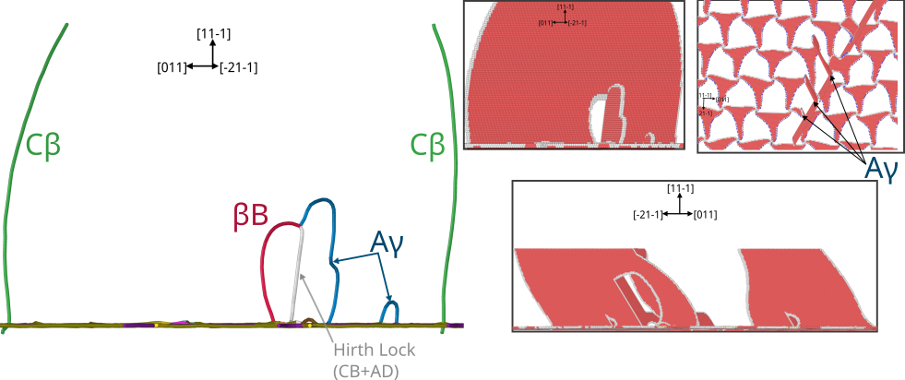
Dislocation generation on intersecting slip planes accompanies development of threading dislocation
Multiple threading dislocations form on same plane

Slide 16
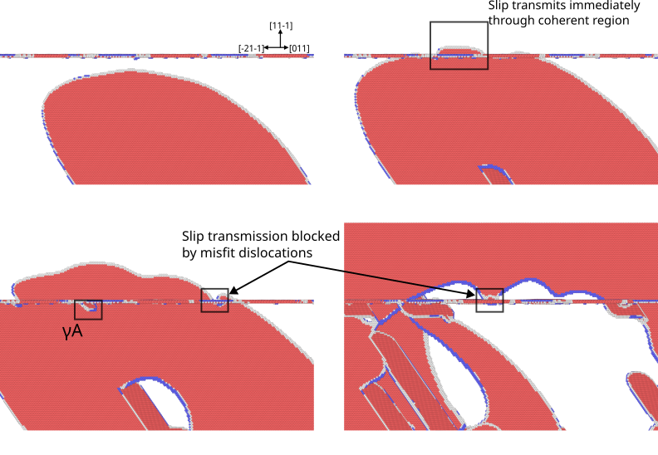
Misfit dislocations are primary obstacles to slip transmission

Slide 17
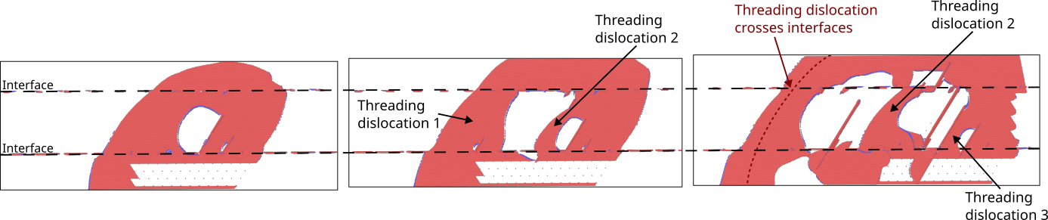
Multiple threading dislocations form on initial glide plane

Slide 18
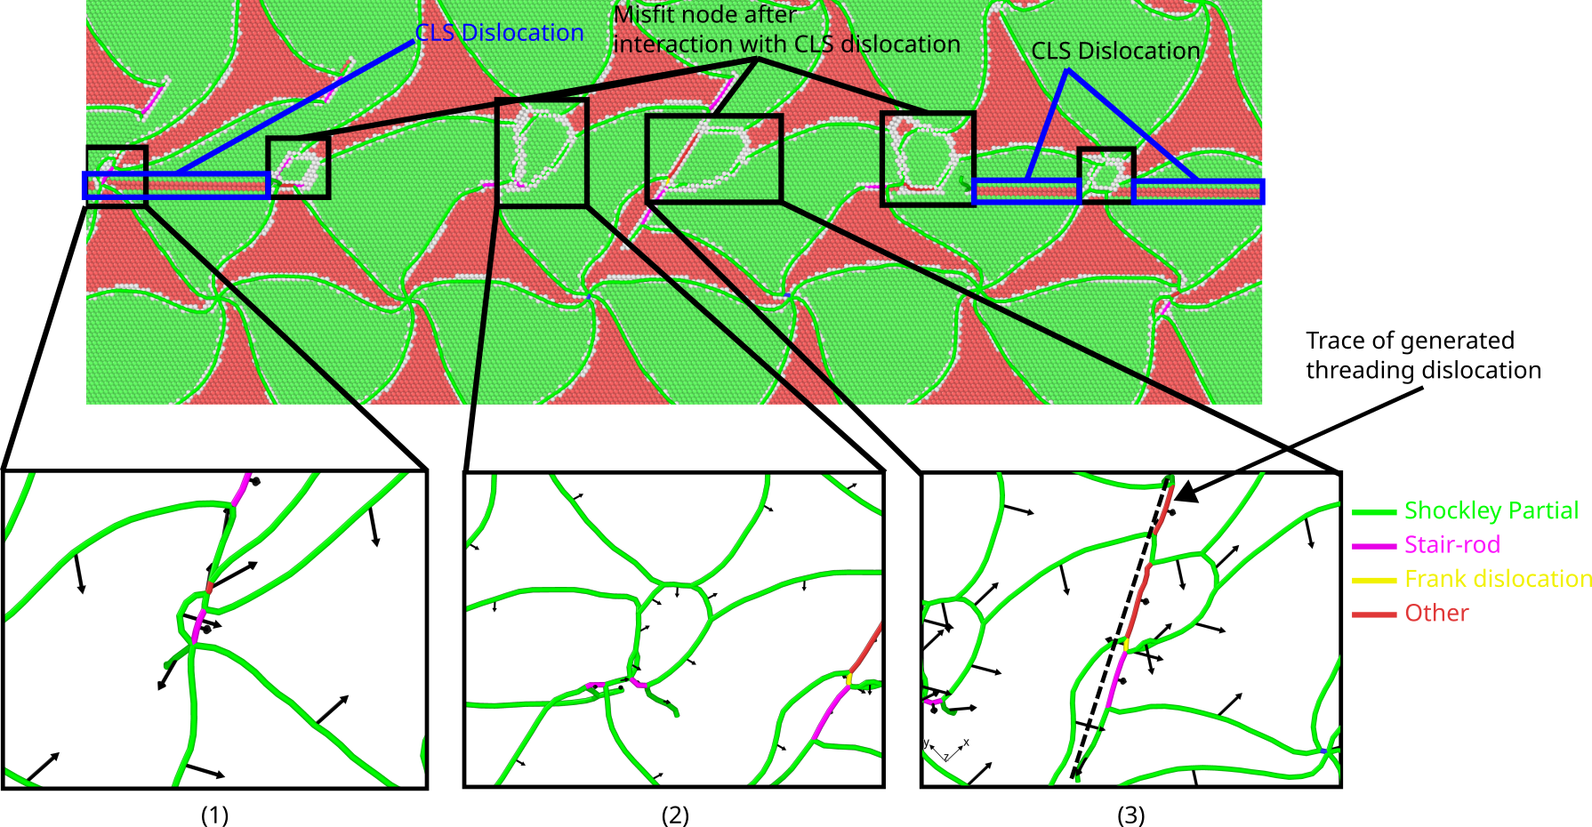
Interaction between CLS dislocation and misfit nodes leads to change of interface structure
Cu side of interface

Slide 19
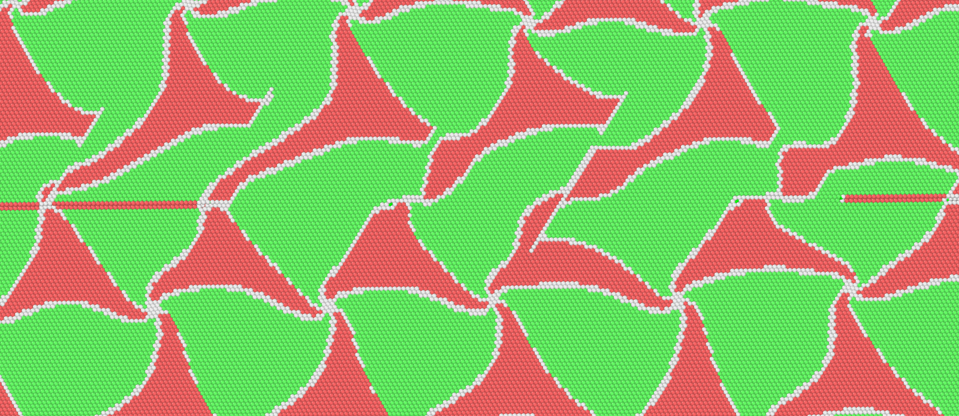
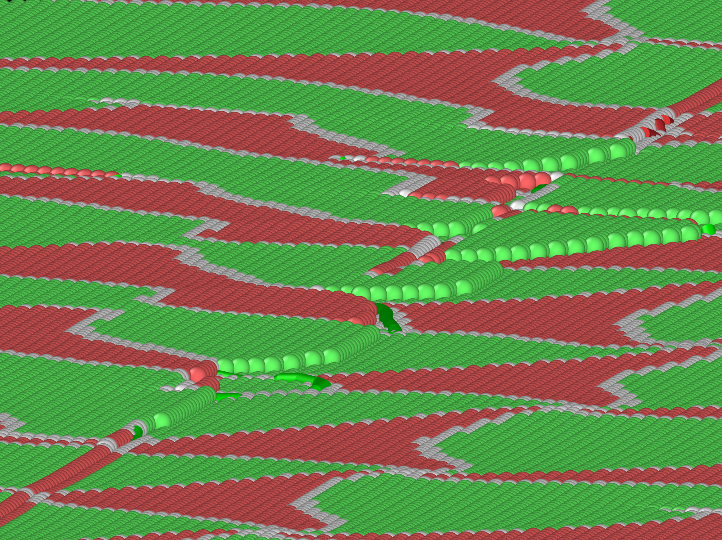
Confined layer slip leads to development of interface disconnection
Constriction of misfit dislocation pattern corresponds to stair-rod dislocation
Step deposited at interface by threading dislocation
Ni side of interface

Slide 20
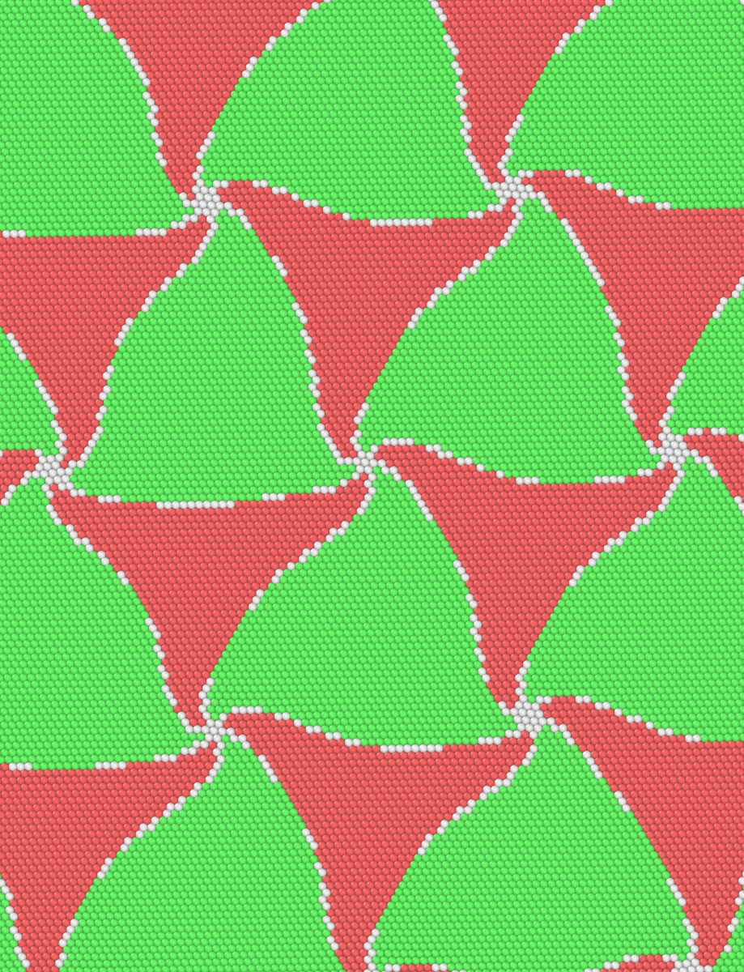
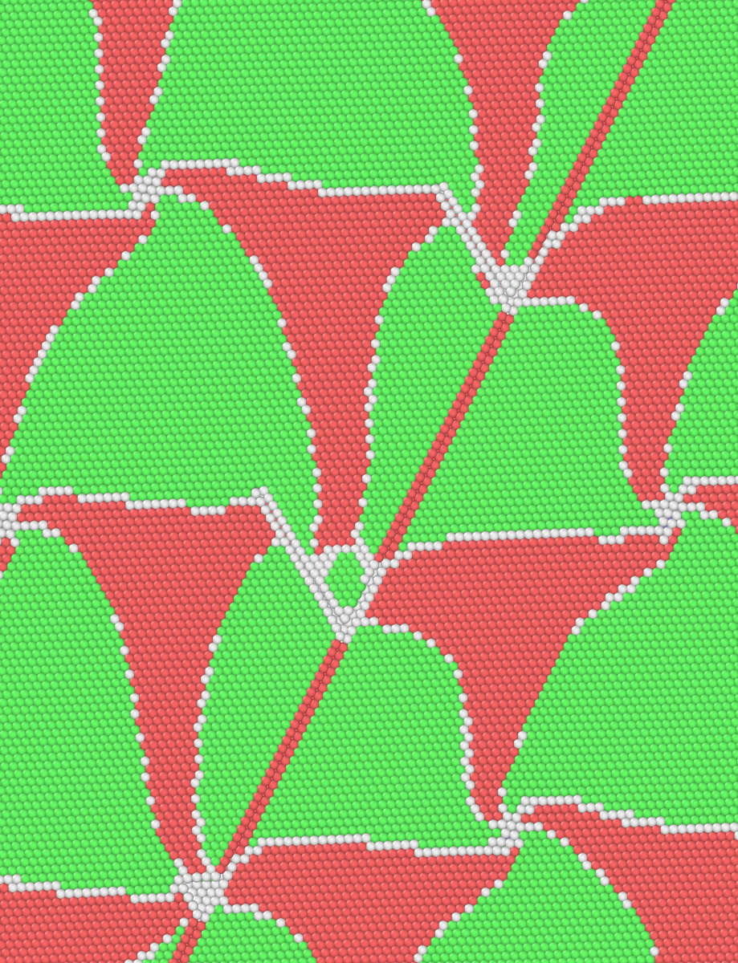
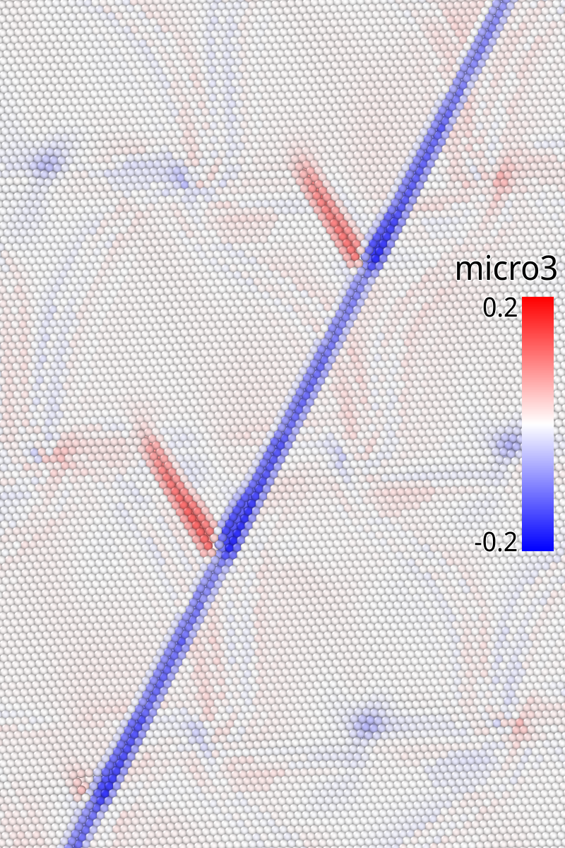
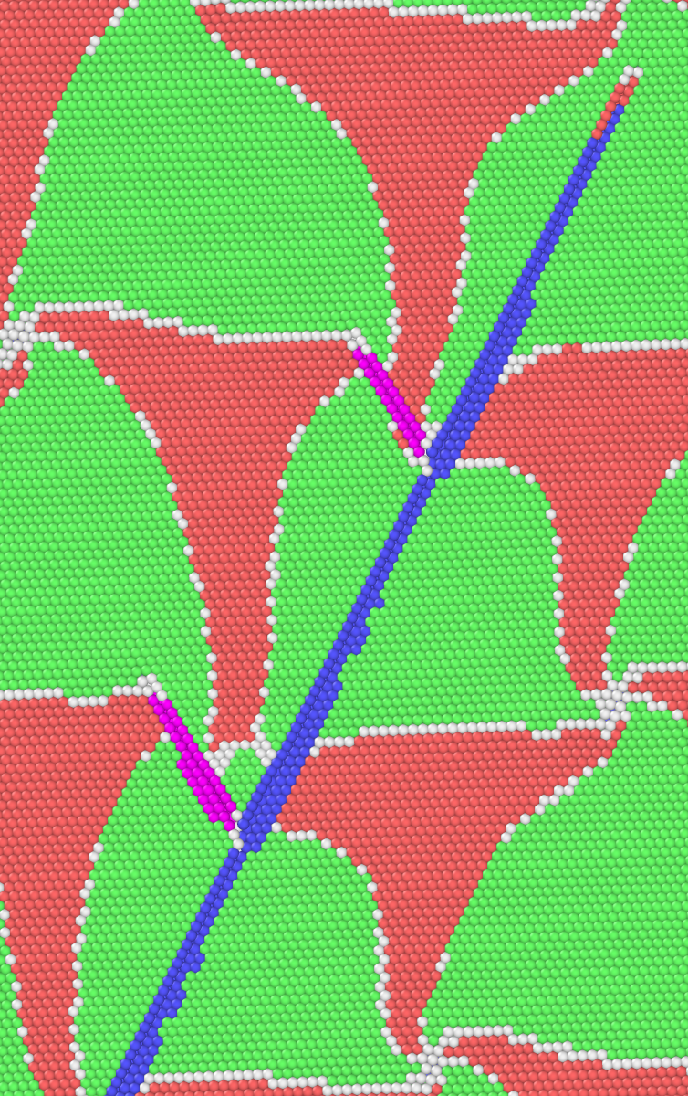
Approximate comparisons of energy barriers by tracking ΔE for participating atoms
Initial
Final
Cδ
Aγ

Slide 21
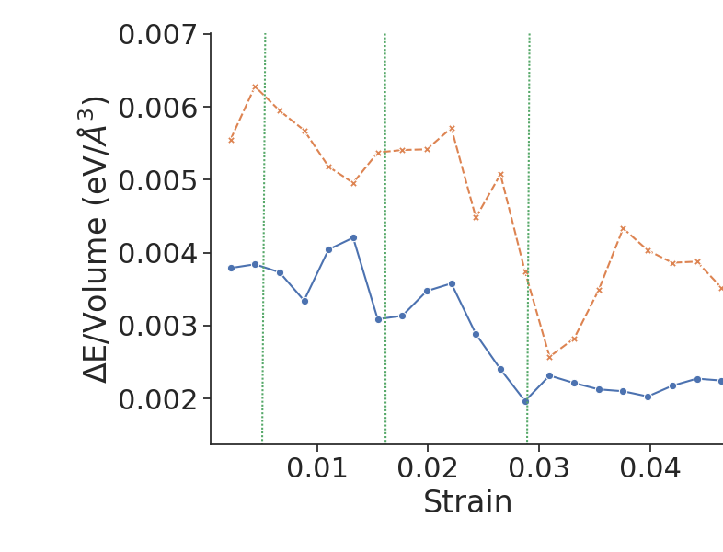
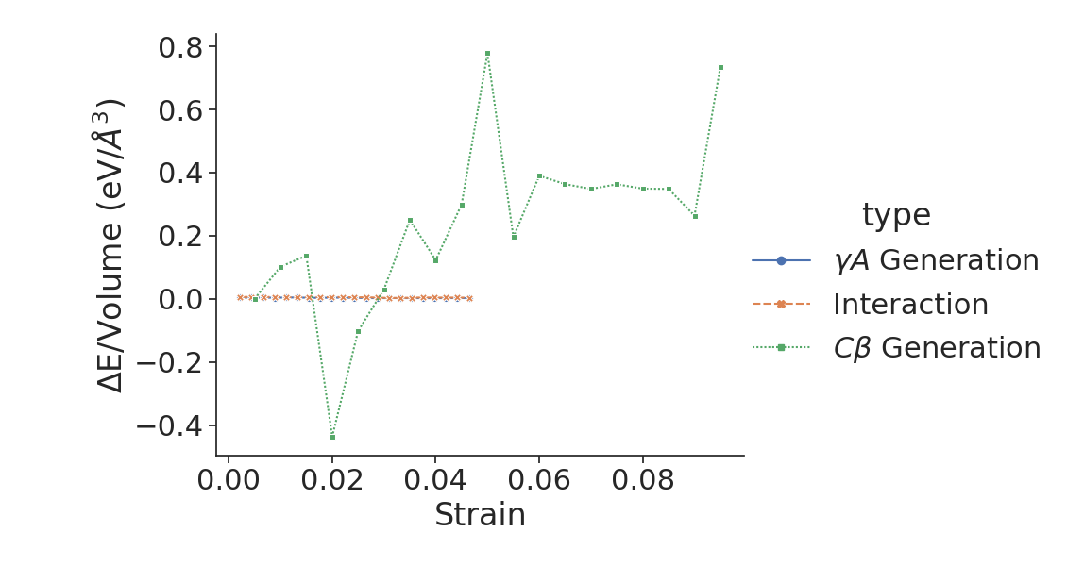
Threading dislocation facilitates generation of γA dislocations

Slide 22
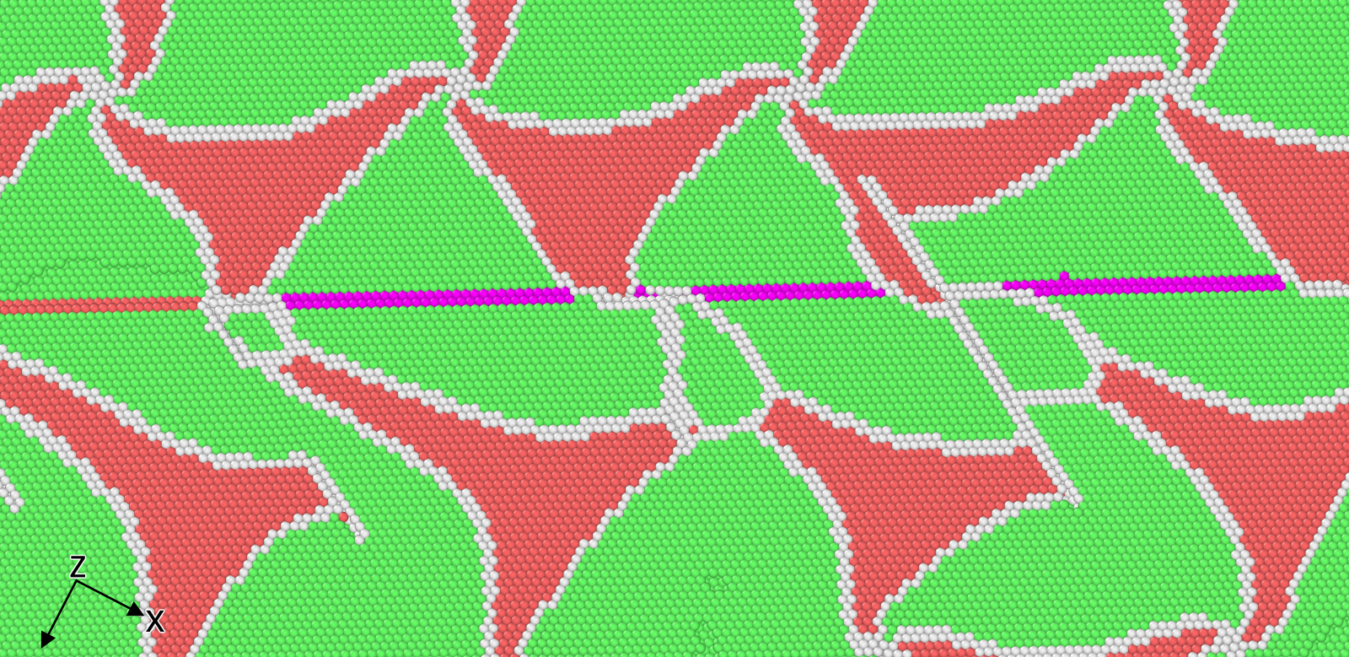
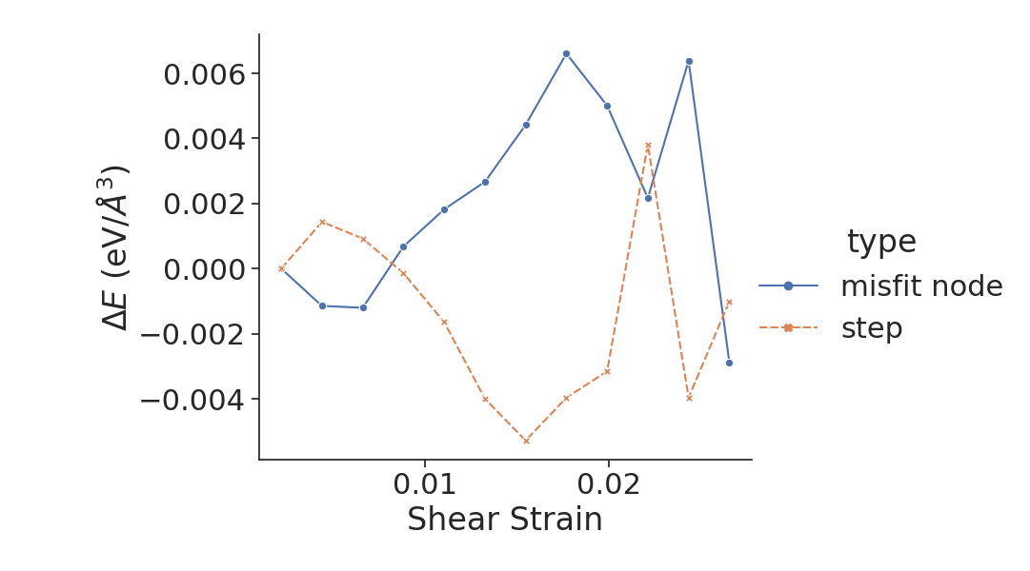
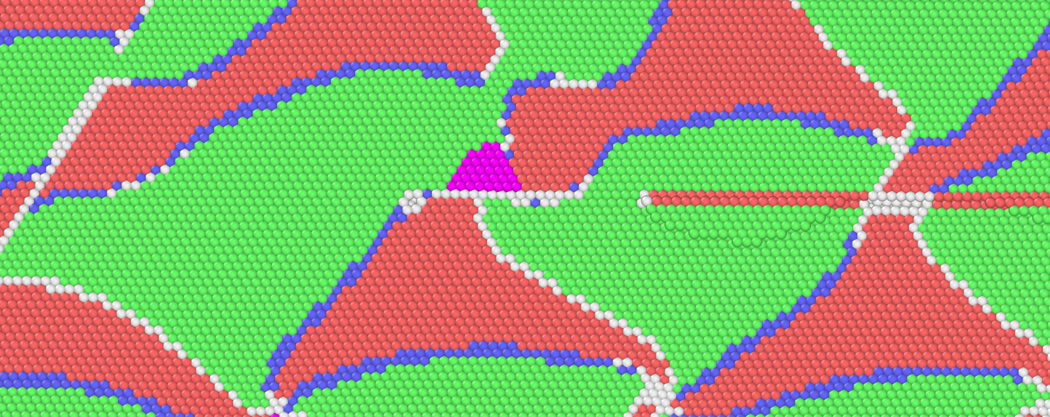
Interface energetics reveal the fundamental role of misfit dislocations in resisting slip transmission
Misfit node
atoms
Step atoms
Leading Partial Interaction
Trailing Partial Interaction

Slide 23
Conclusions
Multiple threading dislocations can form on the same initial slip plane; interface evolution will impact subsequent glide.
Threading dislocation interactions leads to expanded misfit node structure which facilitates emission of dislocations on intersecting slip planes.
Ideal Cu/Ni interface structure cannot accommodate CLS due to low slip transmission.
Creation of interface step has lower energy cost than the misfit node structure changes.

Slide 24




Acknowledgements
This work is based on research supported by the National Science Foundation under the Grants CMMI-1761553.
All presented simulations were conducted using NSF XSEDE resources under the allocation TG-MSS150010.

Slide 25
Thank you! Questions?

Slide 26
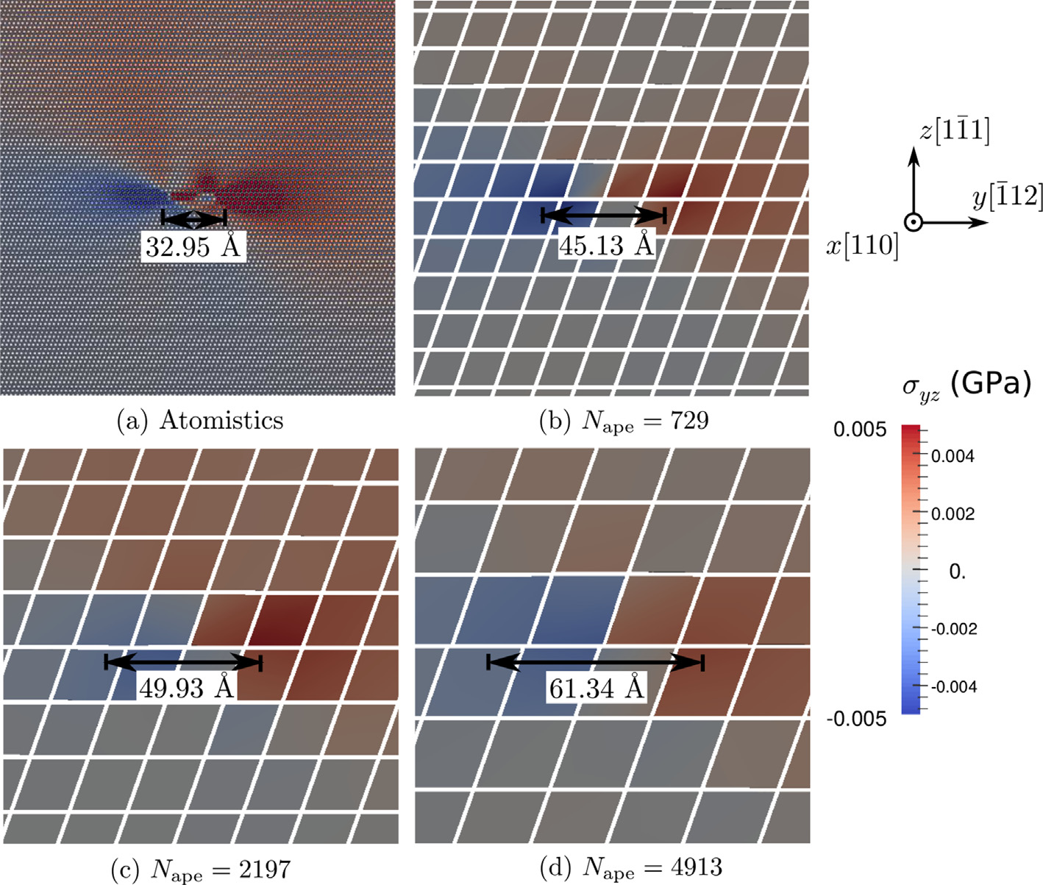
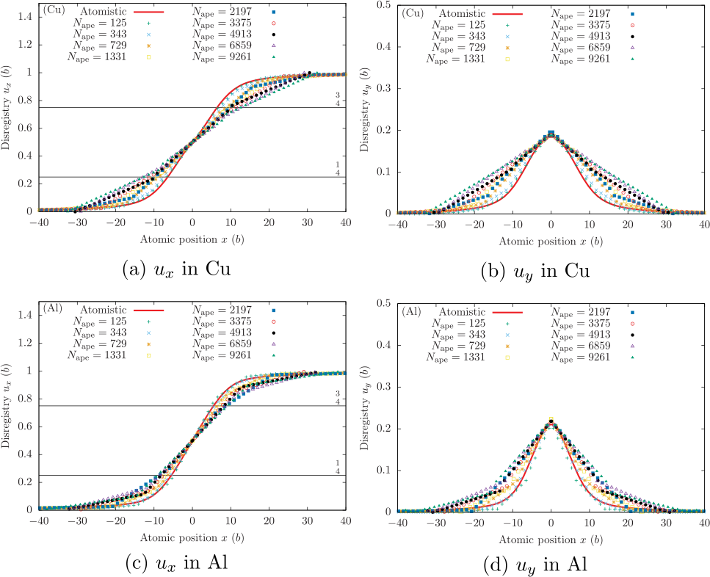
Coarse-graining affects dislocation core structure, long range fields preserved
Stress fields match well with different FE sizes¹
Linear interpolation in FEs smears dislocation core¹
¹S. Xu et al., International Journal of Plasticity, vol. 72, 2015.

Slide 27
Cu/Ni exhibits characteristic spiral interface pattern

Slide 28
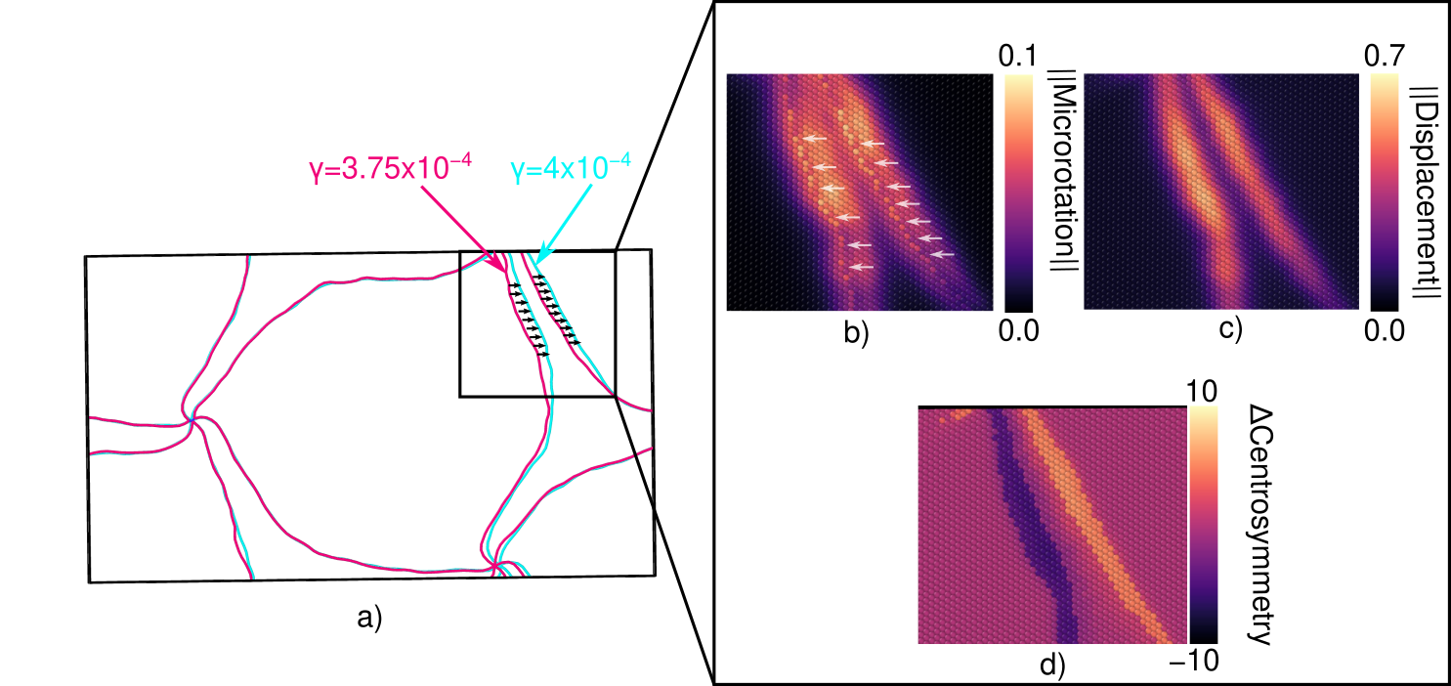
Microrotation analysis of semi-coherent Cu/Ni interfaces

